Slide 1
Stone Age
Mrs Horsley
Home Learning Week 3

Slide 2
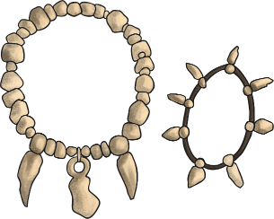
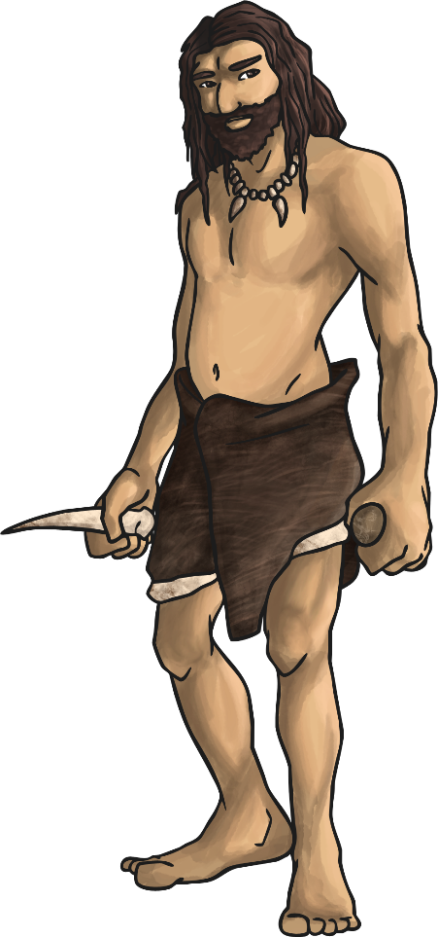
What clothes did they wear?
People wore animal skins to keep them warm, sewn together using bone needles.
The fine bone needles that have been found were probably used for embroidery as well. The bodies of a boy and a girl buried around 28,000 years ago in Russia were found with thousands of ivory beads and fox teeth covering them, work that would have taken years to complete.
We also know that people were weaving fabric back then (which could have been used for clothes) and dying spun plant fibres different colours, so maybe fashion started a lot earlier than you might think!

Slide 3
Your Task:
Can you design your own beads to make your own Stone Age necklace?

Slide 4
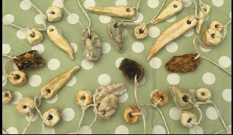
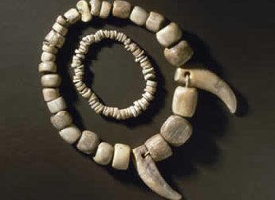
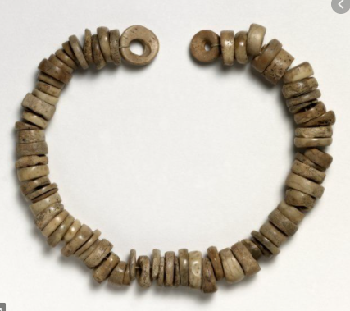
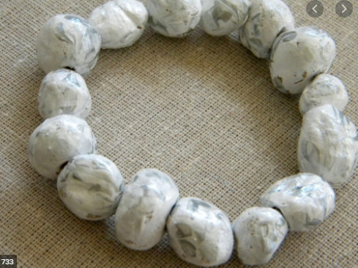
Stone Age Necklaces

Slide 5
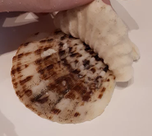
Think about the shapes and sizes of the beads you will use.
1. Shell Designs:
Choose a selection of shells with different patterns and textures to experiment with
Take a lump of dough and press it onto the shell’s surface
Carefully peel away the dough, making sure not to squash the pattern with your fingers

Slide 6
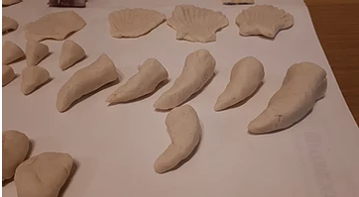
2. Teeth Designs:
Roll a lump of dough into a sausage shape
Place one end of the sausage on the worktop then shape the rest of the sausage into a cone shape with a point at the top
Experiment with different teeth sizes and shapes

Slide 7
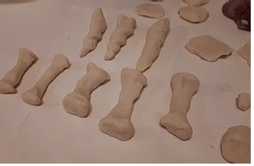
3. Bone Designs:
Roll a lump of dough into a sausage shape
Squash each end of the sausage down slightly to form the wider top and bottom sections of the bone

Slide 8
4. Stone Designs:
Roll a lump of dough into a rough ball
Squash or mould into different stone shapes
Experiment with rough edges or smooth. Perhaps use your shells again to add texture to your stone

Slide 9
You could add a design to your beads too!

Slide 10
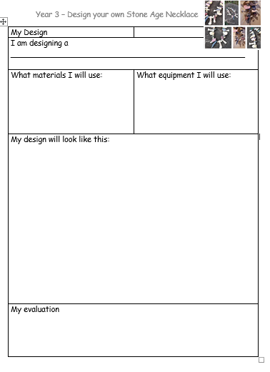
Create your Stone Age Necklace design using this worksheet

