Slide 1
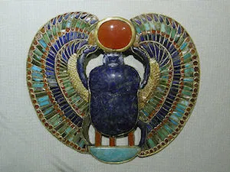
Please access https://www.slideshare.net/devoninglee/6th-egyptian-scarab (please ignore slides 10 and 11)

Slide 2
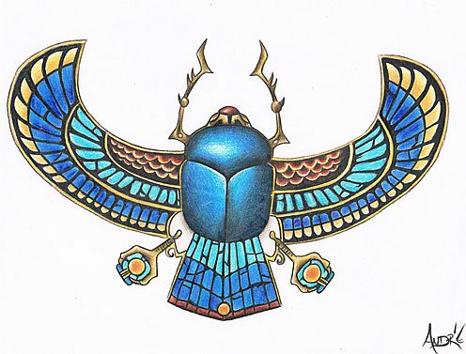
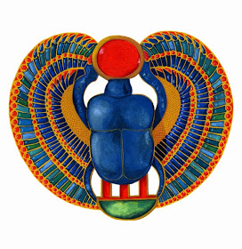
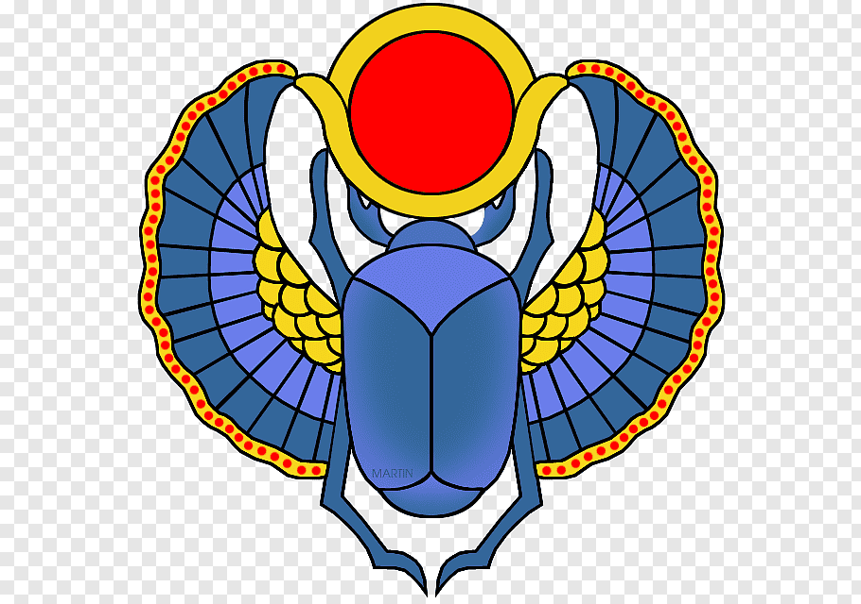
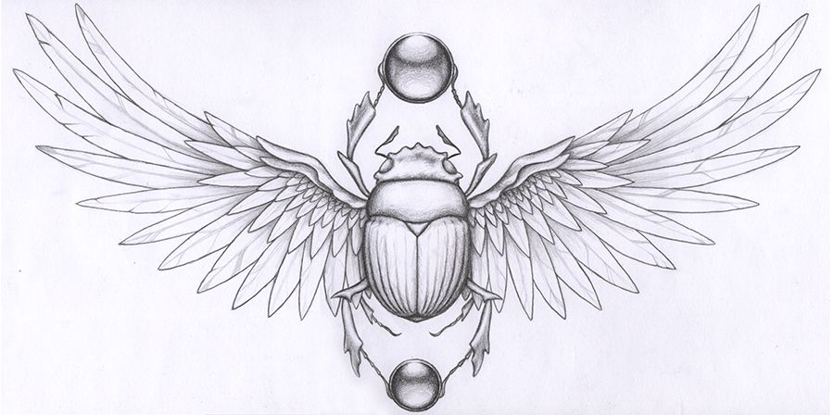
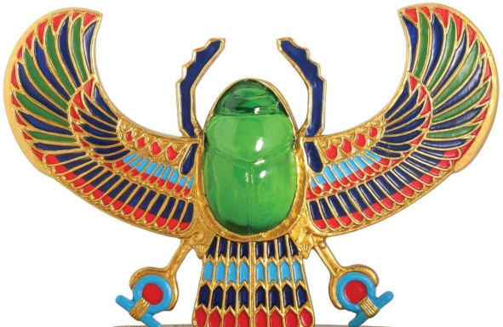
Depending on your resources at home, please try to make a scarab beetle. You can either draw an exquisite beetle adorned with colour or you can have a go at making a beetle with a plastic spoon.

Slide 3
Break the handle off the spoon
(make sure no sharp edges).
Lie spoon like this →
Mix some plaster of paris with water (or air drying clay) and put inside spoon.
Stick some cocktail sticks in plaster of paris/clay for legs and antennae.
Leave to dry.
Once dried, pop plaster of paris/clay out of spoon.
Decorate with paints.
Choice 2

Slide 4
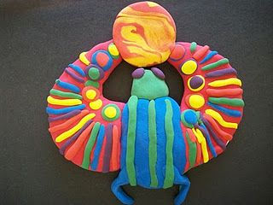
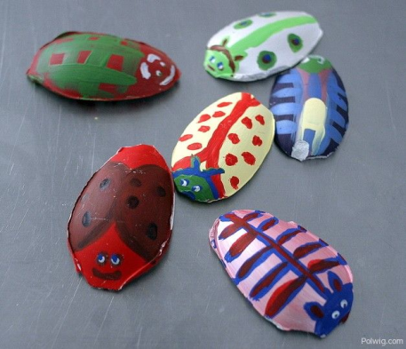
Break the handle off the spoon
(make sure no sharp edges).
Put a lump of play-do in the plastic spoon. Using felt tip pens, colour some cocktail sticks and push in play-do to represent legs and antennae.
Decorate back of spoon with paint.
OR just make a play-do scarab!
Choice 3

