Slide 1
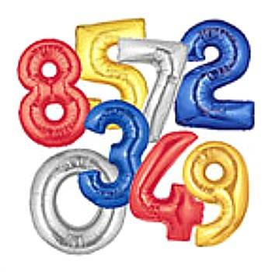
Numeracy
Notes:
1
1
1
1

Slide 2
Converting Fractions to decimals and percentages

Slide 4
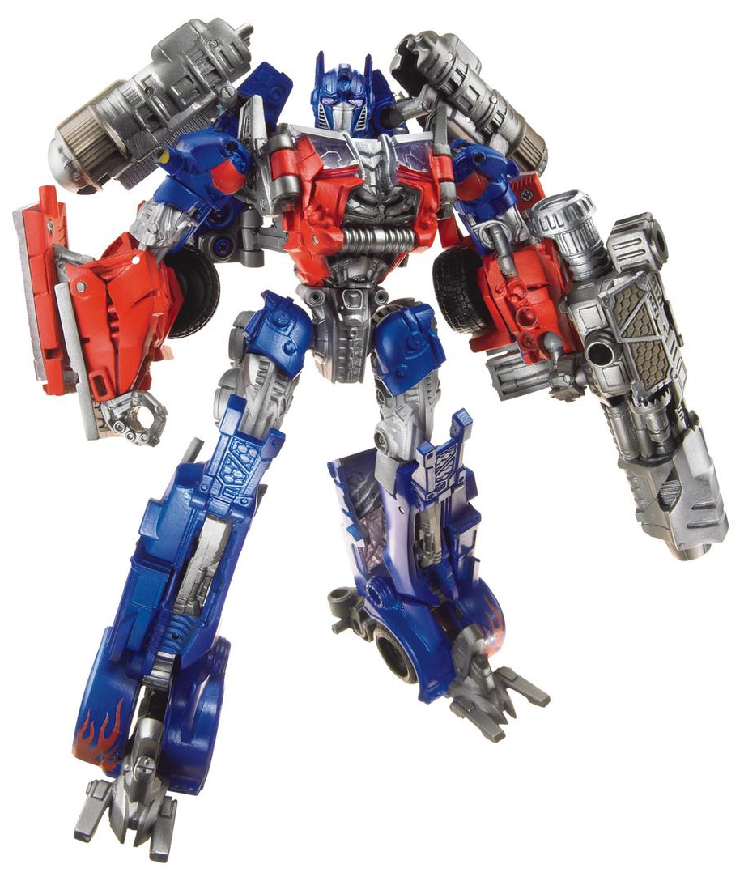
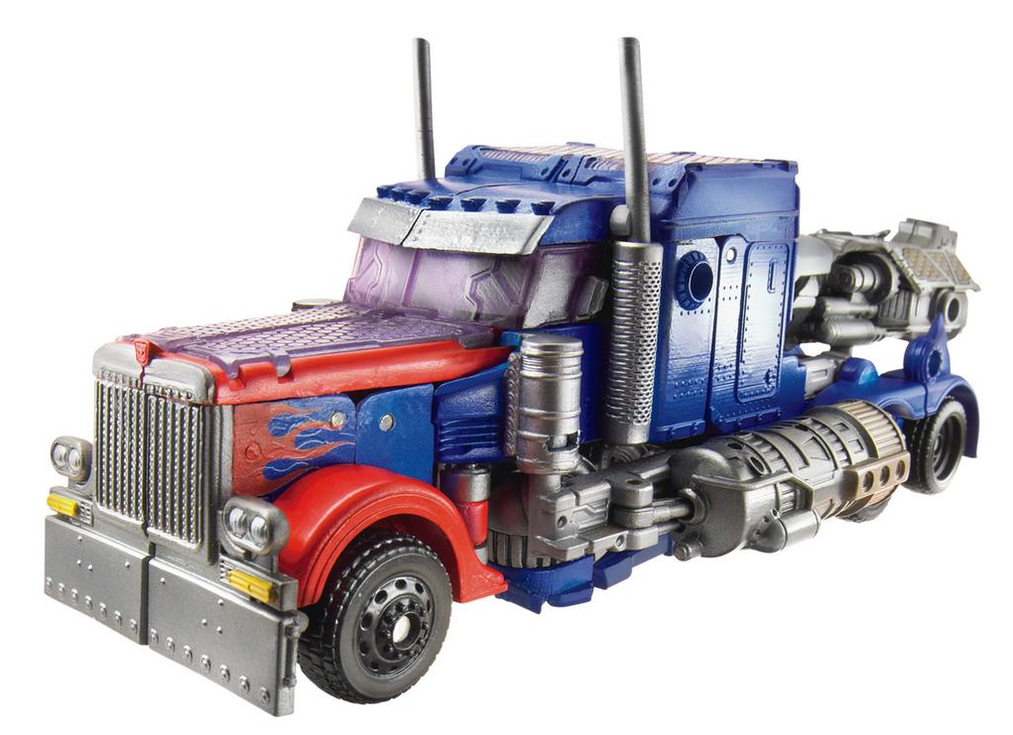
Optimus Prime
... From a robot into a truck and from a truck into a robot ...
BUT IT’S STILL THE SAME GUY!!!

Slide 5
Bumblebee
... From a robot into a car and from a car into a robot ...
BUT IT’S STILL THE SAME GUY!!!

Slide 6
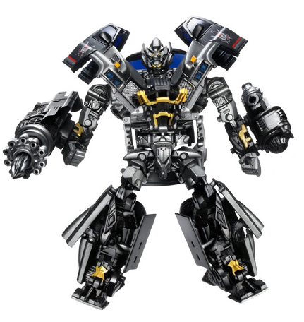
Ironhide
... From a robot into a pickup and from a pickup into a robot ...
BUT IT’S STILL THE SAME GUY!!!

Slide 7
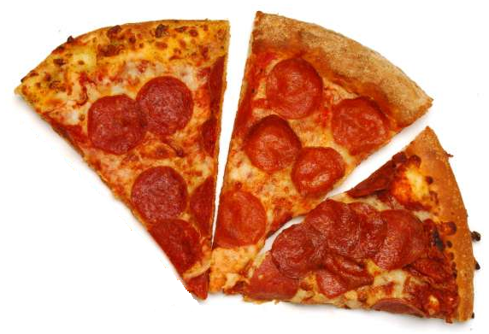
3
8
37.5%
0.375
... From a fraction into a decimal and from a decimal into a percentage ...
BUT IT’S STILL THE SAME GUY!!!
amount of pizza

Slide 8
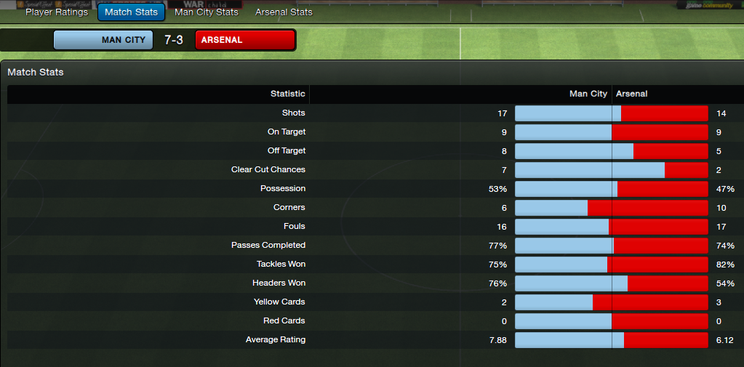
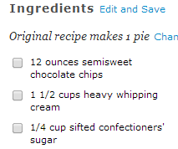
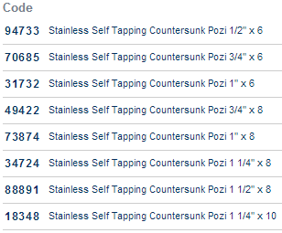
percentages
fractions
decimals
Look different,
but do the same thing:
represent an amount

Slide 9
Whoa!
Stop right there!
If they do the same thing,
why do we need them all?
Surely just one of them would do...

Slide 10
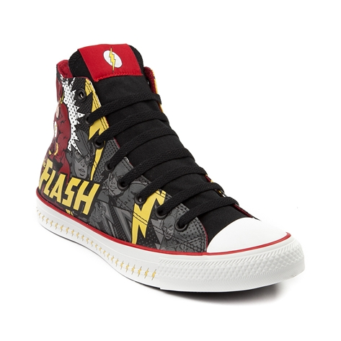
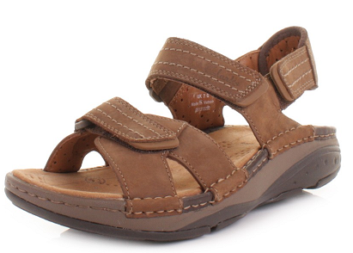
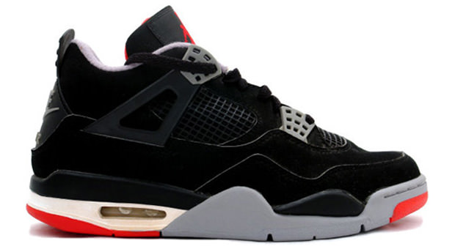
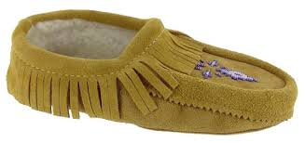
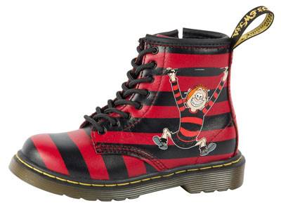
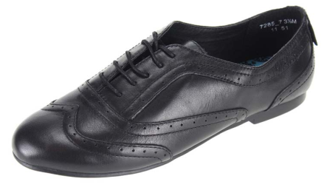
How many shoes do you have?
They do the same thing (protect your feet).
Surely only one pair would do...?
Only one pair?
Don’t make me
angry...

Slide 11
2
5
Sometimes
you can use any of these –
whichever you like the best.
Sometimes
one of them is not appropriate,
while another one is spot on!
0.4
40%
I like the blond one
at the top right...
Cute...

Slide 12
... And that is why we need to know
how to transform from
one shape to another...

Slide 13
Fractions into decimals
3
4
This line has the same meaning as the sign
So:
÷
0.75
3
4
3³0²0
= 4 = 0.75
To change a fraction into a decimal,
we divide its numerator (top)
by its denominator (bottom)

Slide 14
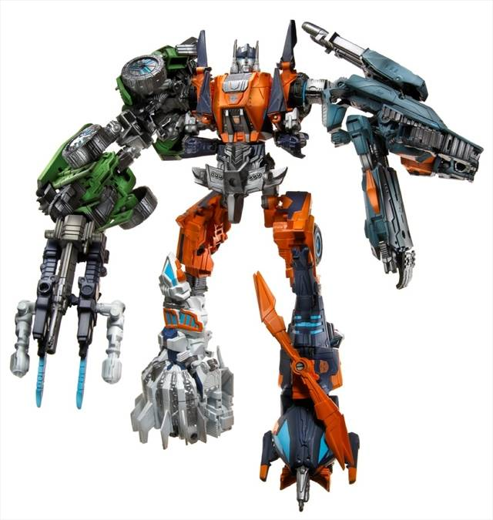
Well, that was easy... When I need to
change, I have to take off my right hand,
then to bend my elbow behind my back,
then to put my left arm through my stomach,
my feet behind my neck...
you really don’t want to know
where I have to put my head...
Anyway, it’s your turn...
Change the fractions on the next slide
into decimals.
If it seems too difficult, take off your right hand,
bend your elbow behind your back, put your left arm through
your stomach, cross your feet behind your neck.......
One more thing, remember when dividing
to stop after carrying three times as it
may be a recurring number. We show this
in class, by putting three dots after the
third number.

Slide 15
Let’s see if you can
change the fractions below into decimals.
Please use the method of division
3
4
4
5
9
10

Slide 16
Did you get the same answers as me?
3
4
4
5
9
10
0.75
0.80
or
0.8
0.90
or
0.9

Slide 17
Have a go at these ones.
Will you get the same answers as me?
5
8
2
3
6
7

Slide 18
Did you get the same answers as me?
5
8
2
3
6
7
0.625
0.666…
0.857…

Slide 19
Decimals into percentages
0.75 x 100% = 0.75 = 75.0% = 75%
v
v
Remember multiplying with 100?
Two zeros in 100 means two “jumps to the right”...
To change a decimal into a percentage,
we simply multiply it by 100%.

Slide 20
Don’t even ask about me, alright?
Grab your pen and change
these decimals into percentages:
0.82 0.33
0.15 0.02
0.001 0.7

Slide 21
Now it’s your turn to change all of these fractions into decimals then percentages
Remember – fraction to decimal divide the numerator by the denominator
Decimal to percentage multiply the decimal by 100%
Are you ready to transform?

Slide 22
FRACTION | DECIMAL | PERCENTAGE
5/8
4/5
3/4
1/3
10/20
2/10
6/8
9/12
4/6
2/3
3/8
22/25
84/100
15/25
Day 1

Slide 23
FRACTION | DECIMAL | PERCENTAGE
4/8
3/6
1/4
2/3
2/6
7/10
10/12
18/20
6/50
7/20
16/20
76/100
24/50
14/25
Day 2

Slide 24
FRACTION | DECIMAL | PERCENTAGE
7/8
3/10
4/20
89/100
1/6
18/20
7/50
16/25
1/8
2/12
43/50
1/7
3/4
23/100
Day 3

Slide 25
The next slides give you the answers – don’t peek at them until you have done your work or I will get Mrs Rusby to transform you some how!

Slide 26
FRACTION | DECIMAL | PERCENTAGE
5/8 | 0.625 | 62.5%
4/5 | 0.8 | 80%
3/4 | 0.75 | 75%
1/3 | 0.333… | 33.3%
10/20 | 0.5 | 50%
2/10 | 0.2 | 20%
6/8 | 0.75 | 75%
9/12 | 0.75 | 75%
4/6 | 0.666… | 66.6%
2/3 | 0.666… | 66.6%
3/8 | 0.375 | 37.5%
22/25 | 0.88 | 88%
84/100 | 0.84 | 84%
15/25 | 0.6 | 60%
Day 1

Slide 27
FRACTION | DECIMAL | PERCENTAGE
4/8 | 0.5 | 50%
3/6 | 0.5 | 50%
1/4 | 0.25 | 25%
2/3 | 0.666… | 66.6%
2/6 | 0.333… | 33.3%
7/10 | 0.7 | 70%
10/12 | 0.833… | 83.3%
18/20 | 0.9 | 90%
6/50 | 0.12 | 12%
7/20 | 0.35 | 35%
16/20 | 0.8 | 80%
76/100 | 0.76 | 76%
24/50 | 0.48 | 48%
14/25 | 0.56 | 56%
Day 2

Slide 28
FRACTION | DECIMAL | PERCENTAGE
7/8 | 0.875 | 87.5%
3/10 | 0.3 | 30%
4/20 | 0.2 | 20%
89/100 | 0.89 | 89%
1/6 | 0.166… | 16.6%
18/20 | 0.9 | 90%
7/50 | 0.14 | 14%
16/25 | 0.64 | 64%
1/8 | 0.125 | 12.5%
2/12 | 0.166… | 16.6%
43/50 | 0.86 | 86%
1/7 | 0.142… | 14.2%
3/4 | 0.75 | 75%
23/100 | 0.23 | 23%
Day 3

