Slide 2
Welcome to my garden!
My name is Sophie.
My favourite flowers are sunflowers and there are lots of them in my garden.
I am going to use my big bricks to measure each sunflower. Would you help me to measure my sunflowers?
I wonder which sunflower is the tallest.

Slide 3
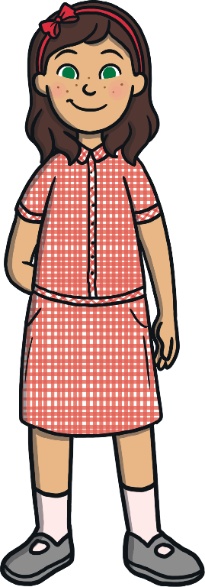
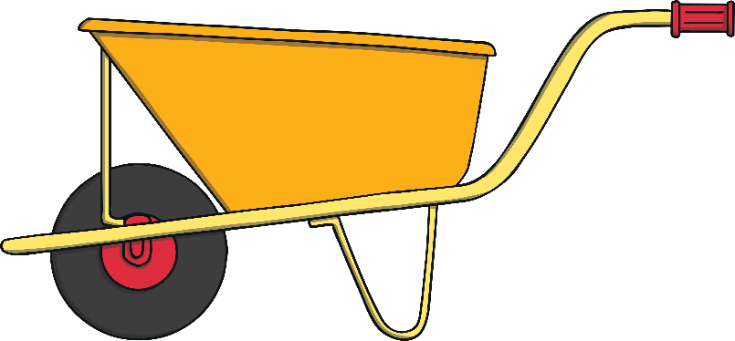
Let’s measure this sunflower. Click the wheelbarrow to build a tower of bricks the same height as the sunflower.

Slide 4
This sunflower is as tall as 2 bricks. Can you tell a friend how to measure a sunflower using bricks?
Top Tip: When you measure a sunflower, make sure you place the bricks right at the bottom of the sunflower and measure all the way to the top.
Make sure the tower of bricks is the same height as the sunflower.

Slide 5
How many bricks tall is this sunflower?
What do you notice about the height of the sunflower and my height?
Click on the wheelbarrow to use bricks to measure the sunflower.

Slide 6
Did I measure this sunflower correctly? Why? Why not?
Click on the wheelbarrow to use bricks to measure the sunflower.

Slide 7
I think this sunflower is 4 bricks tall. Am I correct? How can we check?
Click on the wheelbarrow to use bricks to measure the sunflower.

Slide 8
Have I measured this sunflower correctly? Tell a friend what you think I need to do.
Click on the wheelbarrow to use bricks to measure the sunflower.

Slide 9
We have found the tallest sunflower!
How many bricks do I need to make a tower of the same height?
Click on the wheelbarrow to use bricks to measure the sunflower.

Slide 10
Here are all my lovely sunflowers.

Slide 11
Can you point to the tallest sunflower?

Slide 12
Can you point to the shortest sunflower?

Slide 13
Can you point to a sunflower that is taller than me? Does anyone have a different answer?

Slide 14
Thank you for helping me to measure all of my sunflowers.
Maybe you could try growing and measuring a sunflower too!

