Slide 1
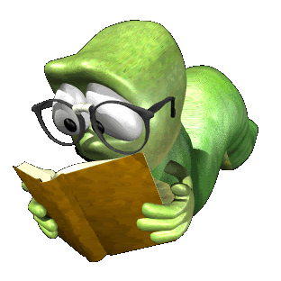
English
Notes:
1
1
1
1

Slide 2
Haiku

Slide 3
A haiku has a structure of
5 syllables
7 syllables
5 syllables

Slide 4
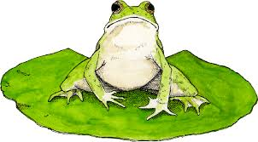
Green and speckled legs, Hop on logs and lily pads Splash in cool water.

Slide 5
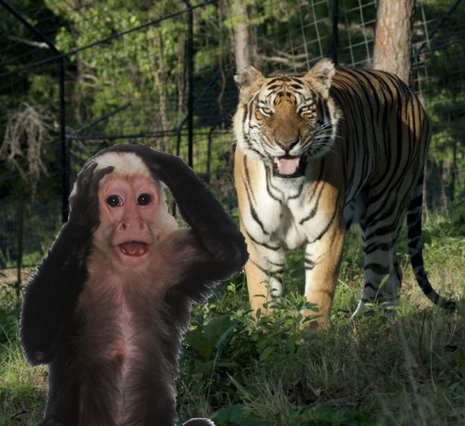
A little monkey, Wanting to find some berries, Watch out here’s tiger!

Slide 6
Tanka

Slide 7
Line 1 – 5 syllables Line 2 – 7 syllables Line 3 – 5 syllables Line 4 – 7 syllables Line 5 – 7 syllables

Slide 8
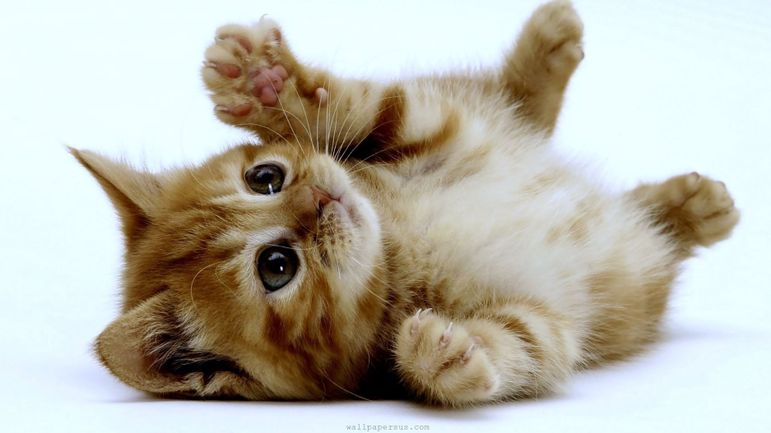
I love my kitten. She is so little and cute. She has a pink tongue, And lots of long whiskers too. She purrs when I stroke her back.

Slide 9
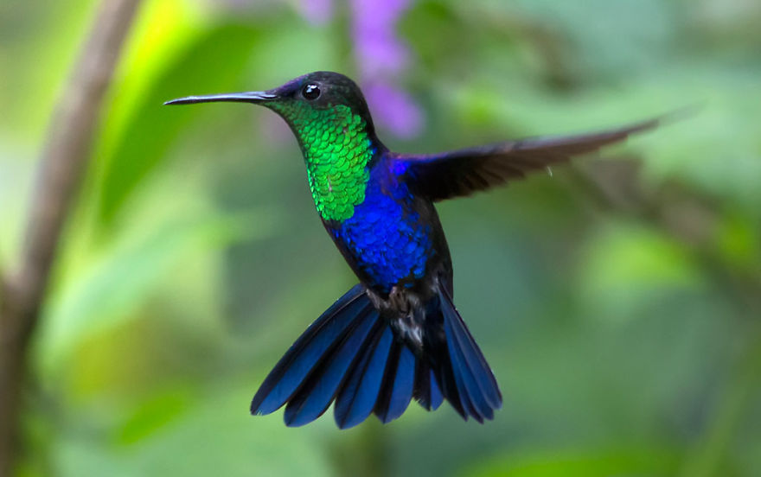
With the trees swaying
Birds can fly from tree to tree
As it slows birds flow
With the leaves staying on trees
Keeping the birds wide awake

Slide 10
Cinquain

Slide 11
Line 1: 1 word - noun (2 syllables ) Line 2: 2 words – adjective (4 syllables) Line 3: 3 words – verbs ending in ing (6 syllables) Line 4: 4 words – phrase (8 syllables)
Line 5: 1 word – noun (2 syllables)

Slide 12
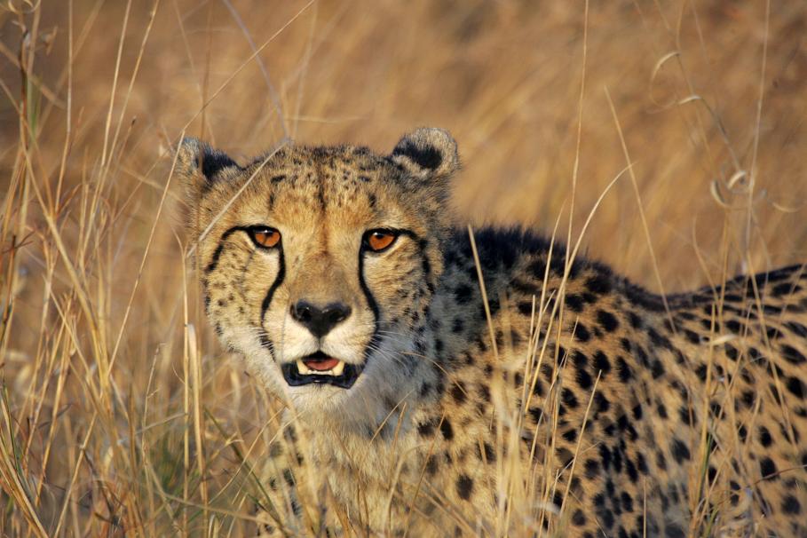
Cheetah
Spotted Killer
Running, Hunting, Fighting,
Through the Grasslands of Africa
Fast Cat

Slide 13
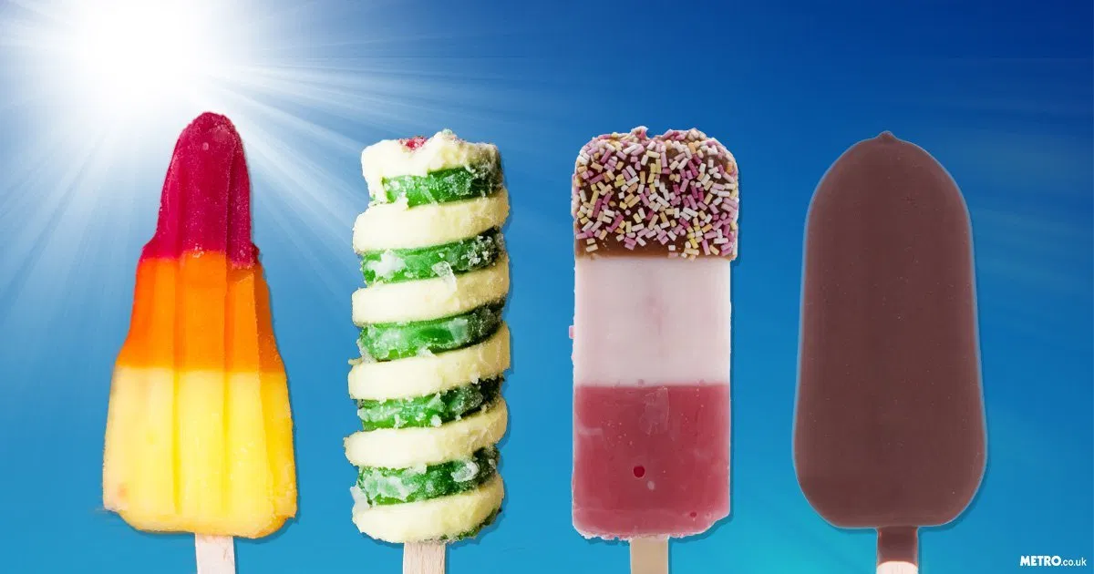
Y
Lollies
Chewy, Yummy
Buying, Biting, Enjoying
I Love Eating Them
Cold!

Slide 14
DIAMANTE
(Must be in the shape of a diamond when written)

Slide 15
Line 1: Beginning subject - noun Line 2: Two adjectives about line 1 Line 3: Three verbs about line 1 Line 4: A short phrase about line 1, a short phrase about line 7 Line 5: Three verbs about line 7 Line 6: Two adjectives about line 7 Line 7: End subject - noun

Slide 16
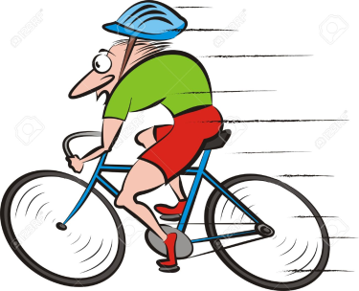
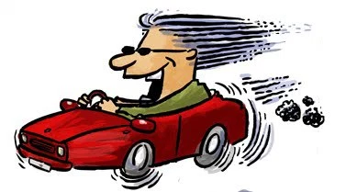
Bike Shiny, quiet, Pedalling, spinning, weaving Whizzing round corners, zooming along roads Racing, roaring, speeding Fast, loud, Car

Slide 17
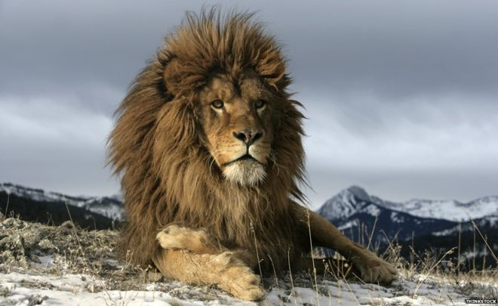
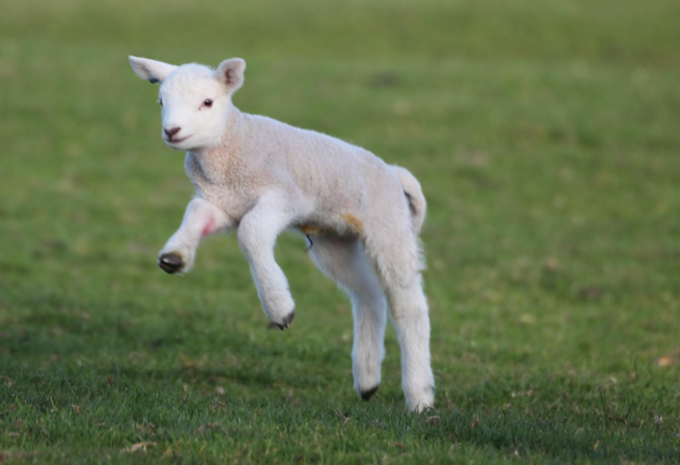
Lion
Handsome, Proud,
Roaring, Snarling, Prowling,
Mane, Muscle, Fleece, Fluffy,
Bleating, Leaping, Grazing,
Meek, Gentle
Lamb

Slide 18
Quatrain

Slide 19
4 lines of poetry
Lines 1 and 3 must rhyme
Lines 2 and 4 must rhyme

Slide 20
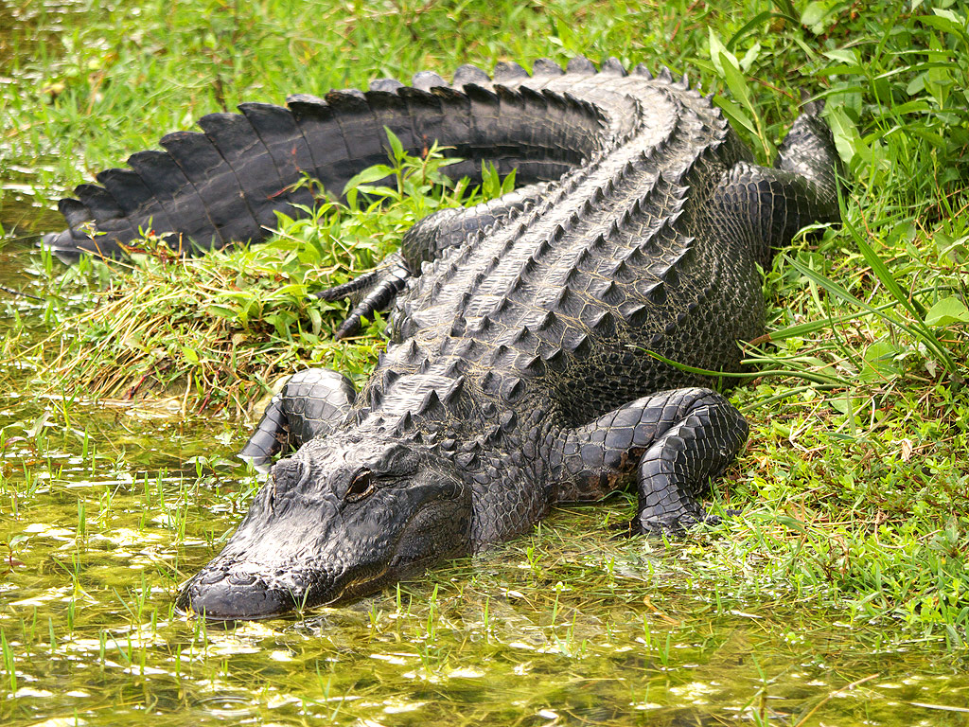
The alligator chased his tail,
Which hit him in the snout,
He let out a great big wail,
And turned inside out.

Slide 21
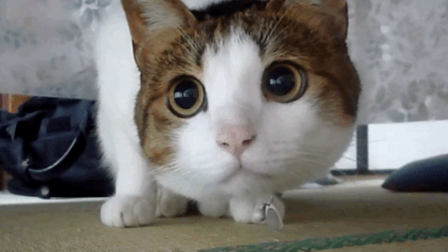
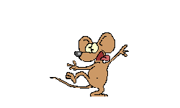
Once there was a white and brown cat,
That liked to eat a lot of mice,
He got all round and fat,
Because they tasted so nice.

