Slide 1
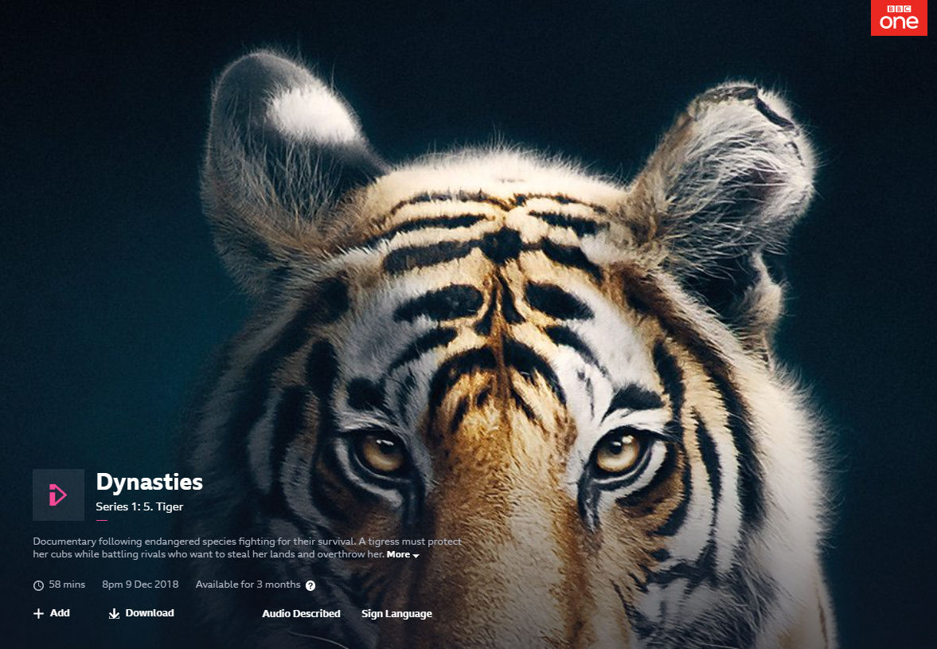
David Attenborough: Persuasive Speech

Slide 2
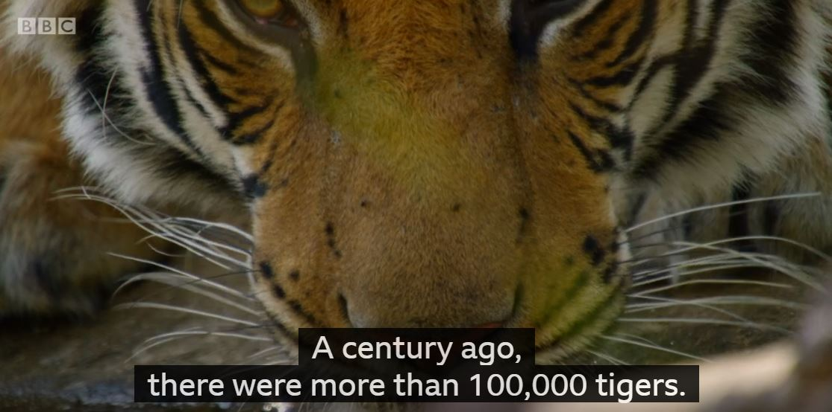

Slide 3
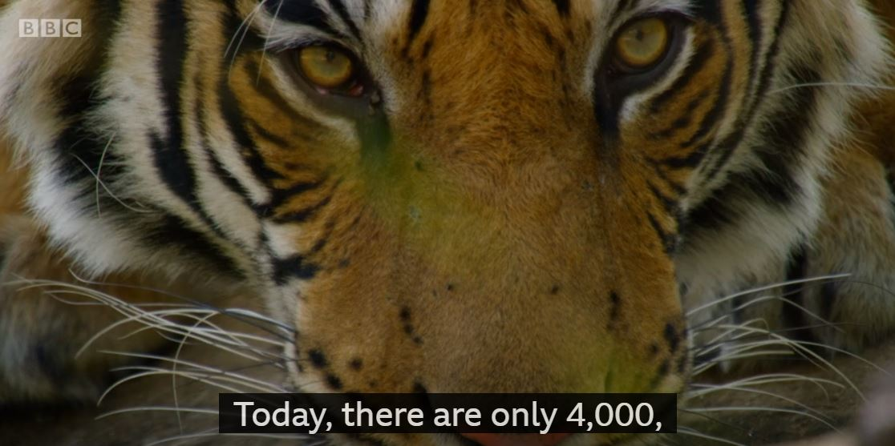

Slide 4
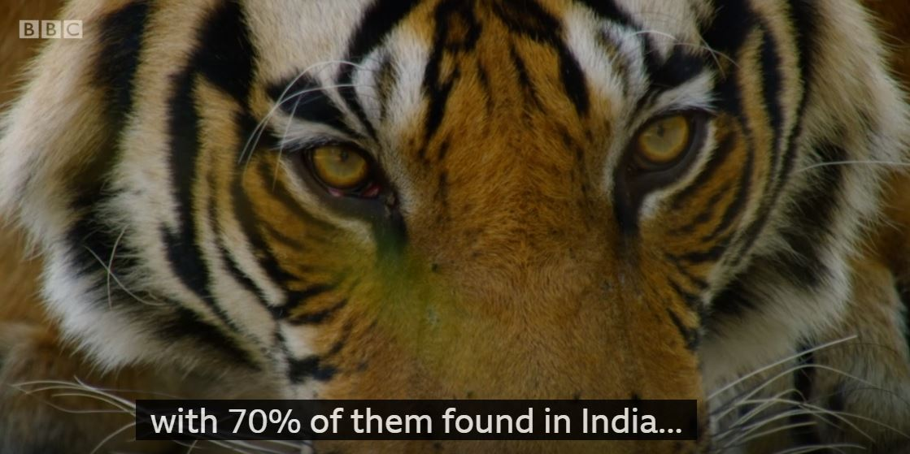

Slide 5
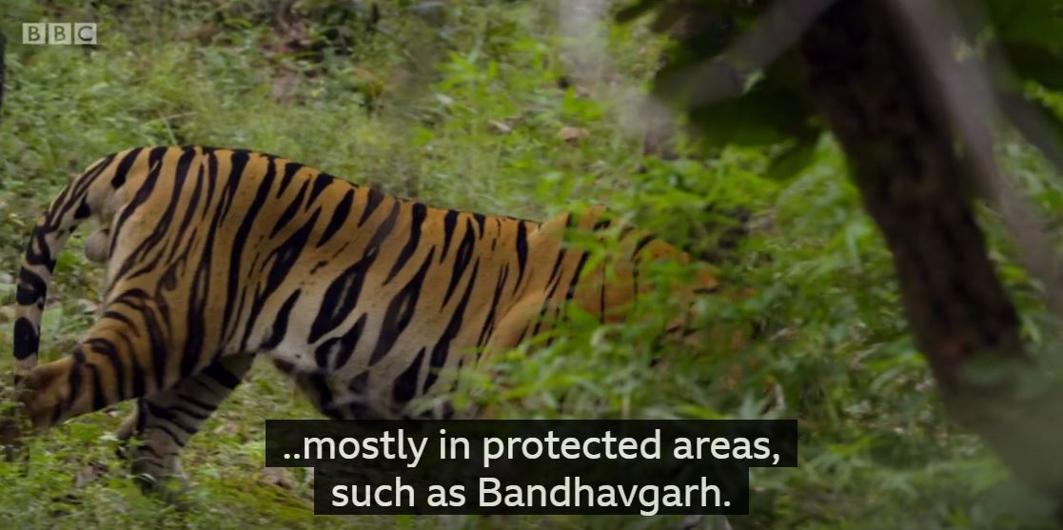

Slide 6
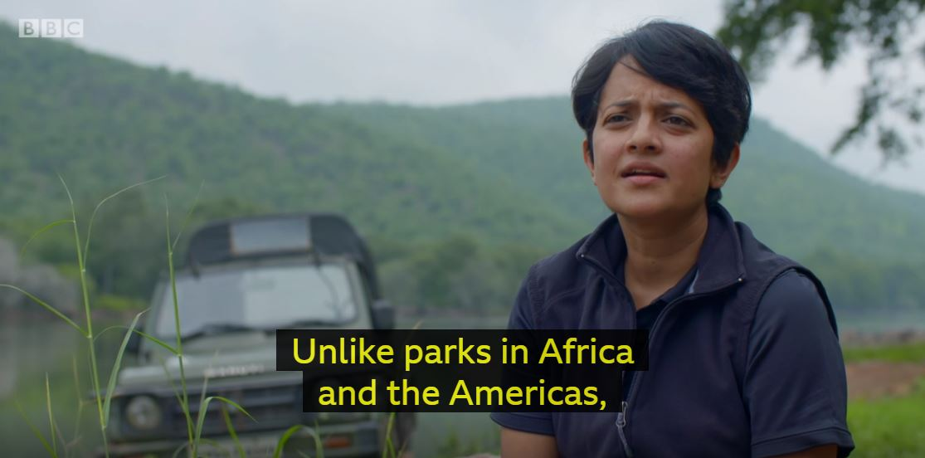
Krithi Karanth, an Indian conservationist

Slide 7
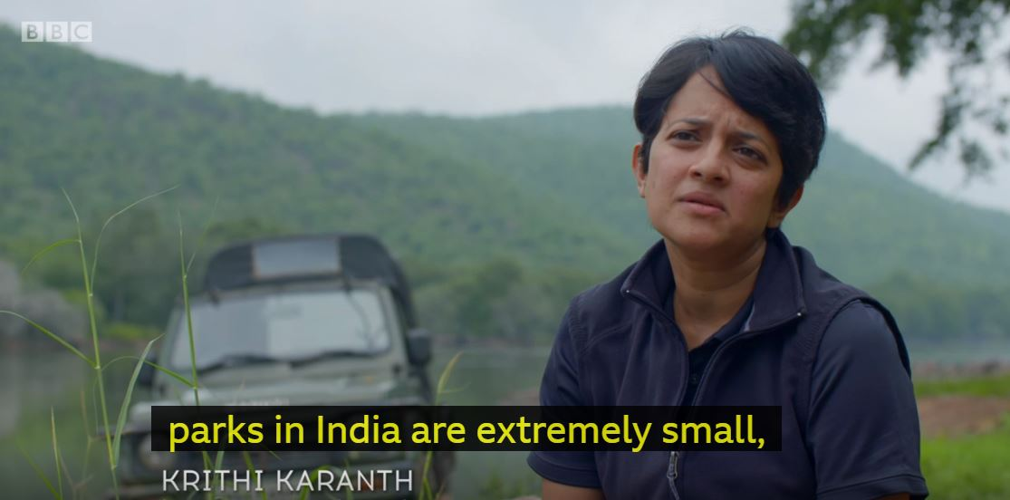

Slide 8
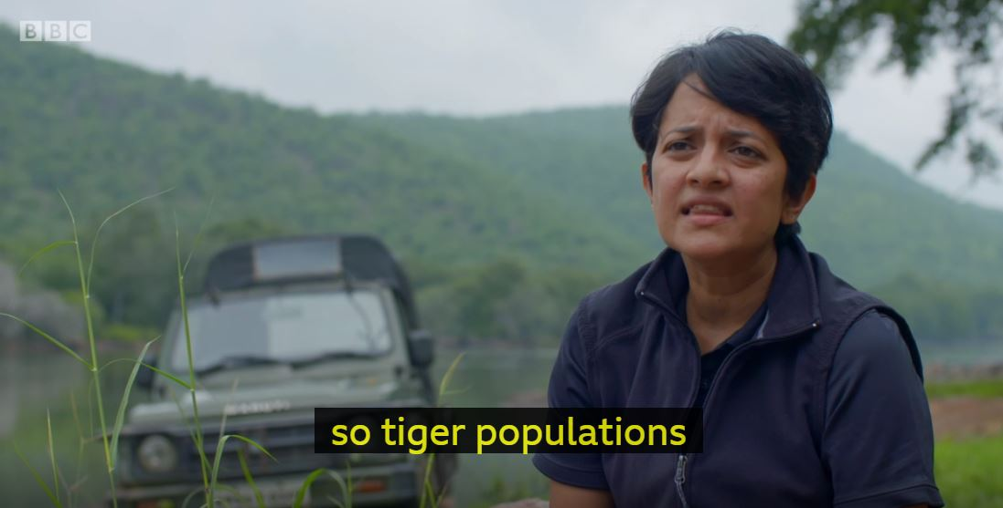

Slide 9
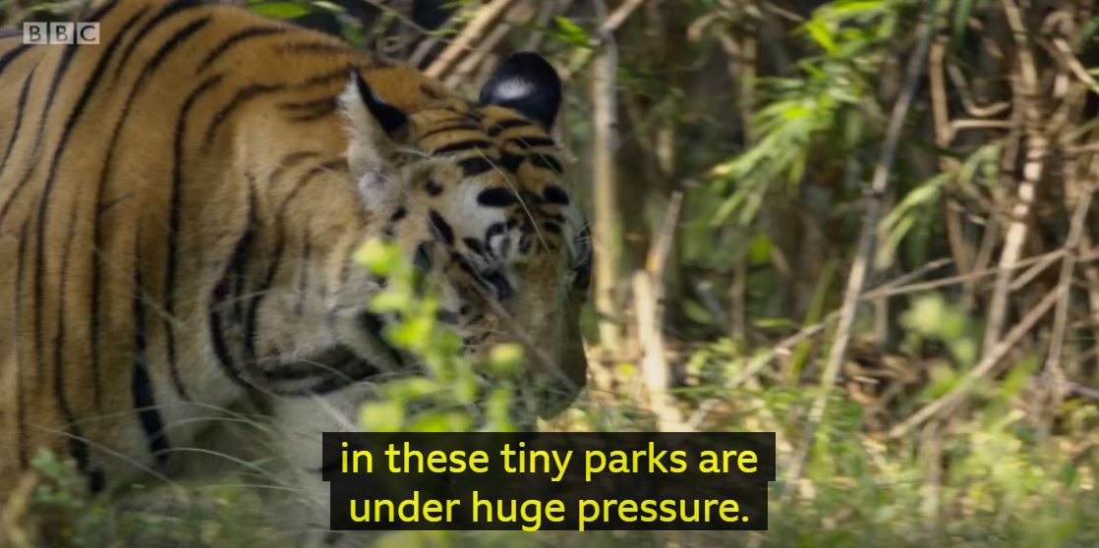

Slide 10
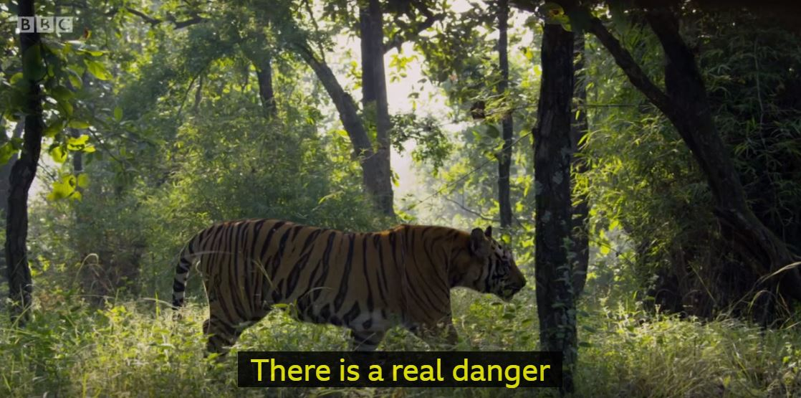

Slide 11
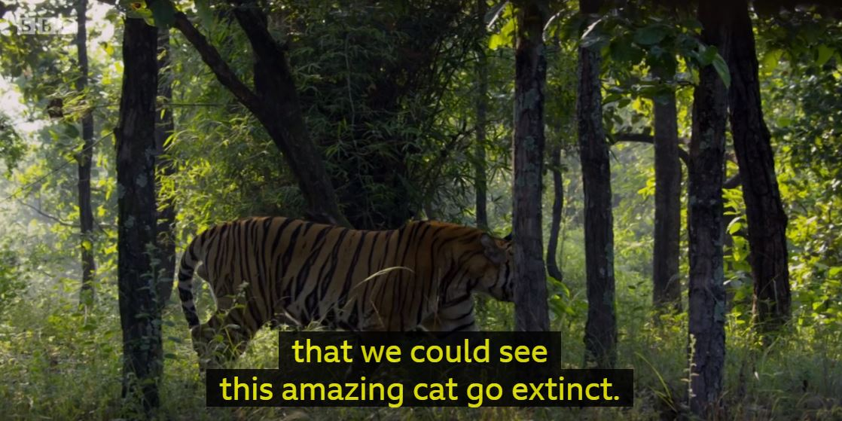

Slide 12
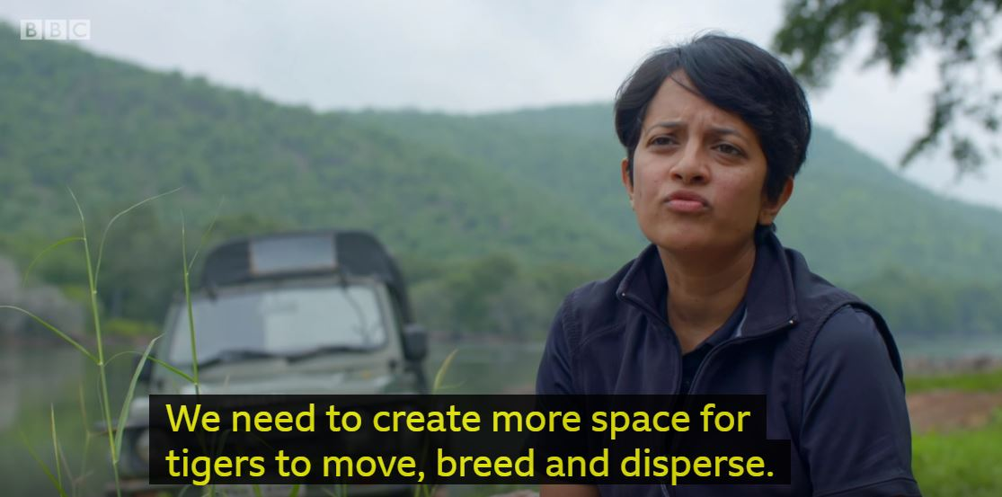

Slide 13
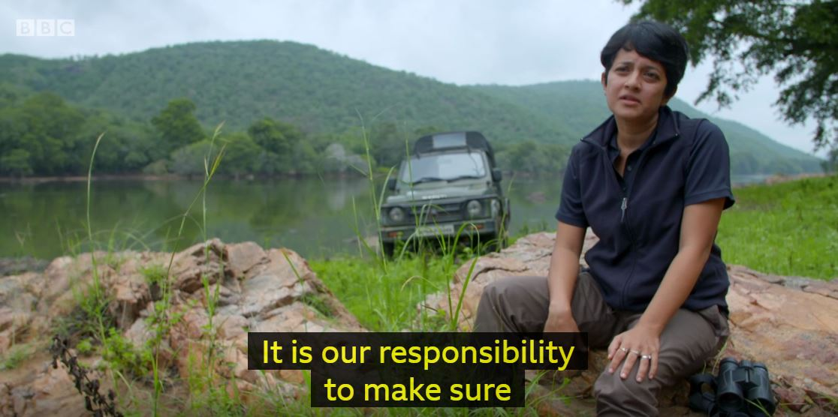

Slide 14
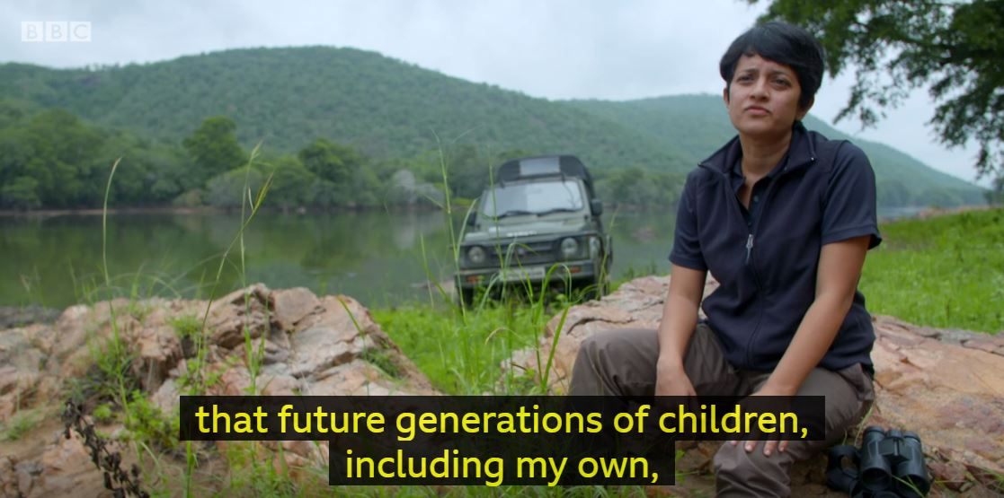

Slide 15
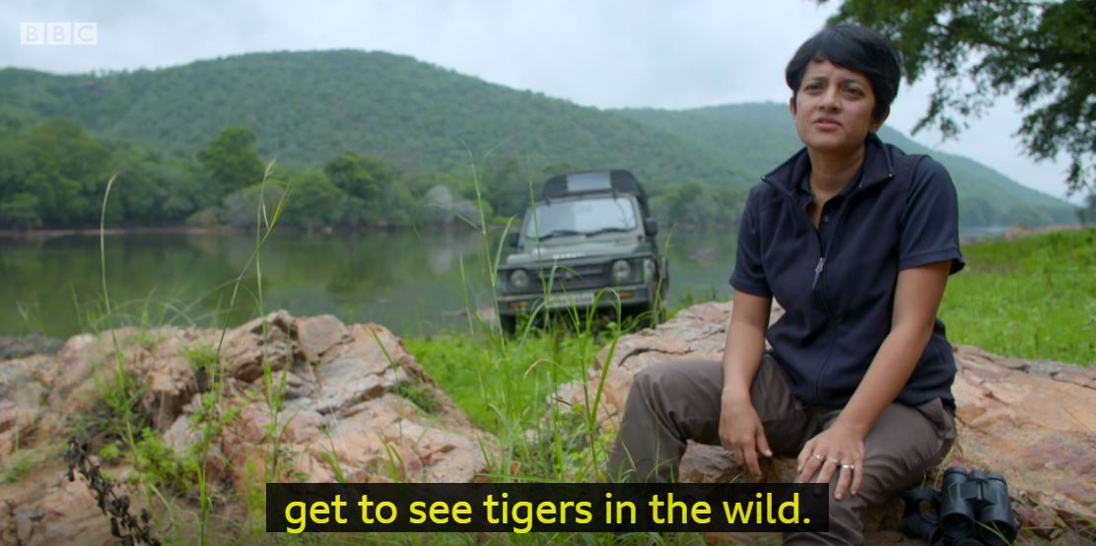

Slide 16
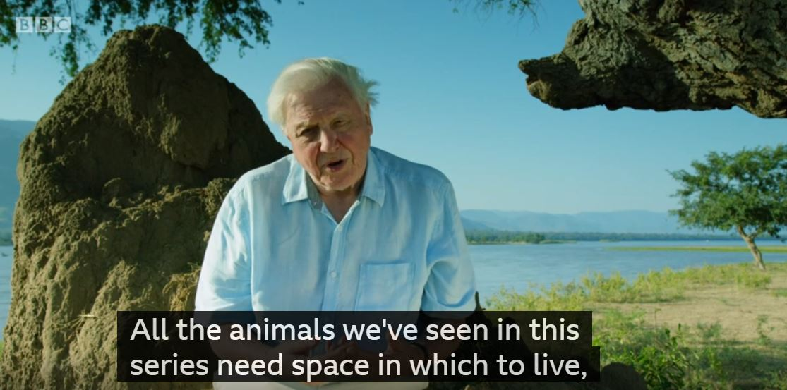

Slide 17
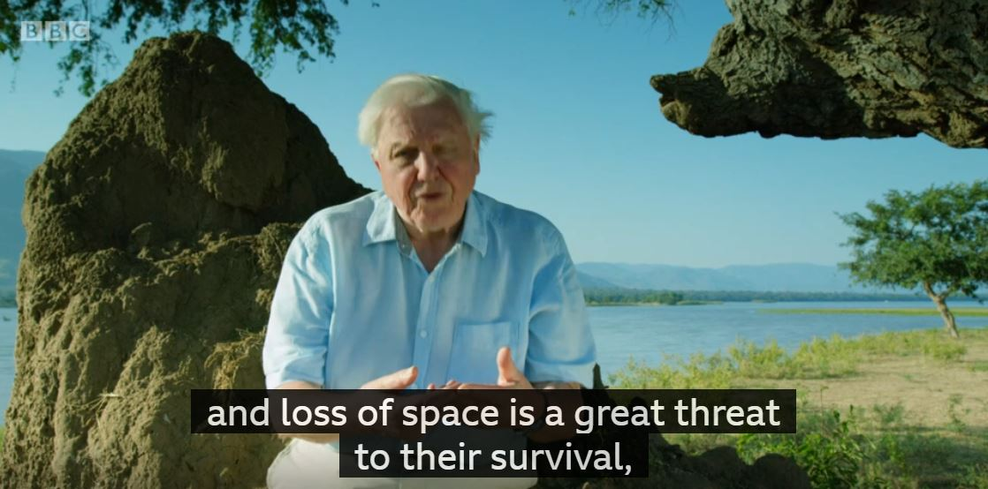

Slide 18
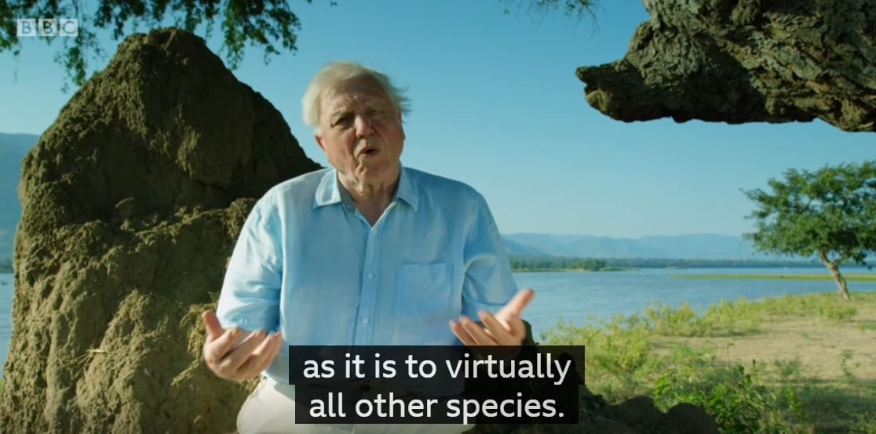

Slide 19
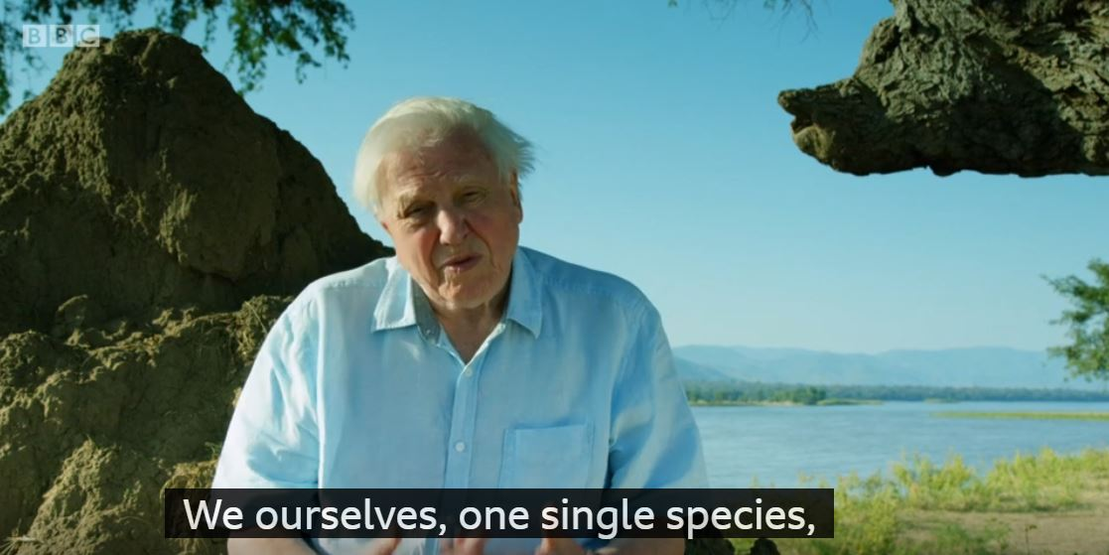

Slide 20
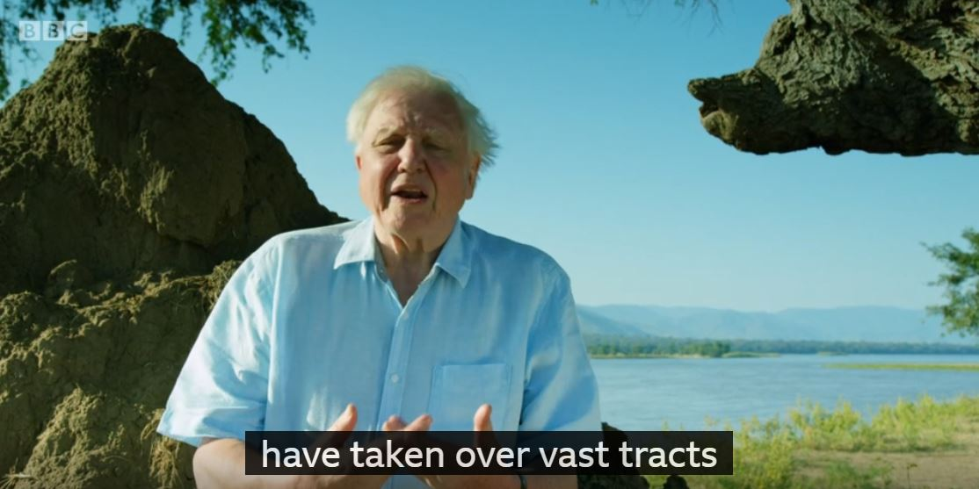

Slide 21
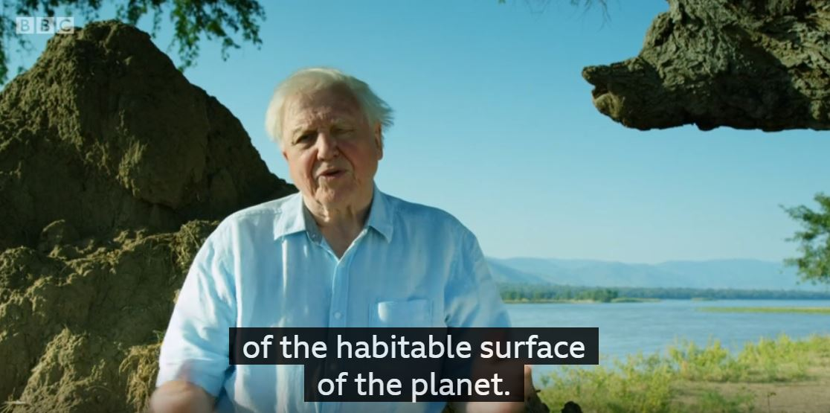

Slide 22
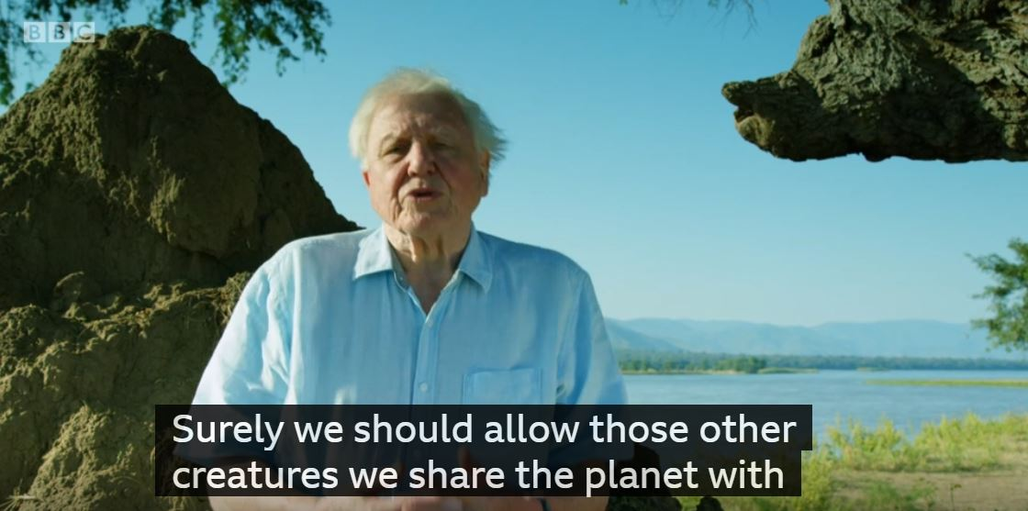

Slide 23
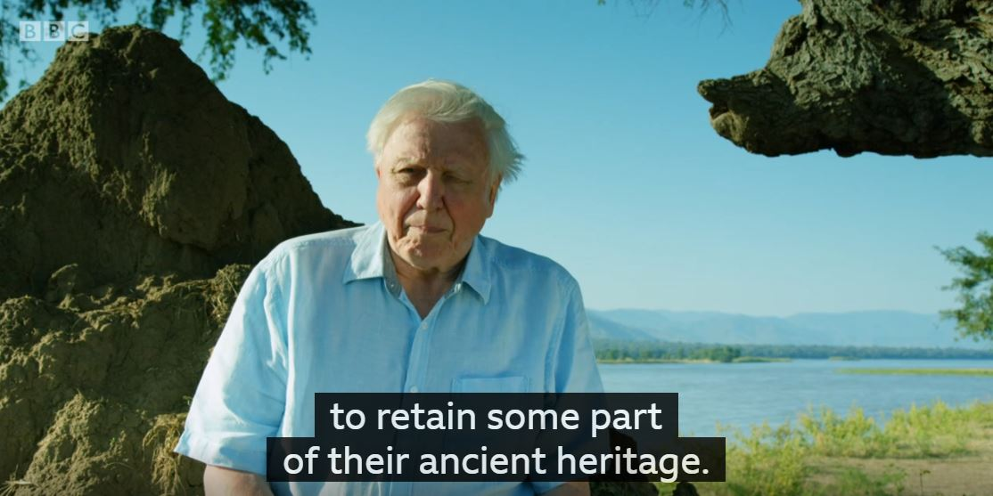

Slide 24
Gives some facts (numbers, place names are included)
A century ago, there were more than 100,000 tigers. Today, there are only 4,000, with 70% of them found in India, mostly in protected areas, such as Bandhavgarh.
Unlike parks in Africa and the Americas, parks in India are extremely small, so tiger populations in these tiny parks are under huge pressure. There is a real danger that we could see this amazing cat go extinct.
We need to create more space for tigers to move, breed and disperse. It is our responsibility to make sure that future generations of children, including my own, get to see tigers in the wild.
All the animals we’ve seen in this series need space in which to live, and loss of space is a great threat to their survival, as it is to virtually all other species.
We ourselves, one single species, have taken over vast tracts of the habitable surface of the planet. Surely we should allow those other creatures we share the planet with to retain some part of their ancient heritage?
Explains the problem clearly
Suggests what needs to happen next and talks about future generations
Spreads the same idea to more animal species
Puts some responsibility on the viewers

