Slide 1
Tlāloc
is a member of the pantheon of gods in Aztec religion.
As supreme god of the rain, Tlaloc is also a god of
earthly fertility and of water. He was widely
worshipped as a beneficent giver of life and
sustenance. However, he was also feared for his
ability to send hail, thunder and lightning and for
being the lord of the powerful element of water.
Tlaloc is also associated with caves, springs, and
mountains, most specifically the sacred mountain
in which he was believed to live in. His animal forms
include herons and water-dwelling creatures such
as amphibians, snails and possibly sea creatures,
particularly shellfish. The Mexican marigold,
Tagetes lucida, known to the Aztecs as yauhtli,
was another important symbol of the god and
was burned as a ritual incense in native religious
ceremonies.

Slide 2
In Aztec images, Tlaloc is usually depicted with goggle eyes and fangs. He is most often coupled with lightning, maize and water in artwork. Offerings dedicated to Tlaloc in Tenochtitlan were known to include several jaguar skulls and even a complete jaguar skeleton. Jaguars were considered the ultimate sacrificial animal due to their value.
Your task : draw the image of Tlaloc (slide 3 simpler version, slide 4 complicated version) and you could use this information in your PowerPoint presentation

Slide 3
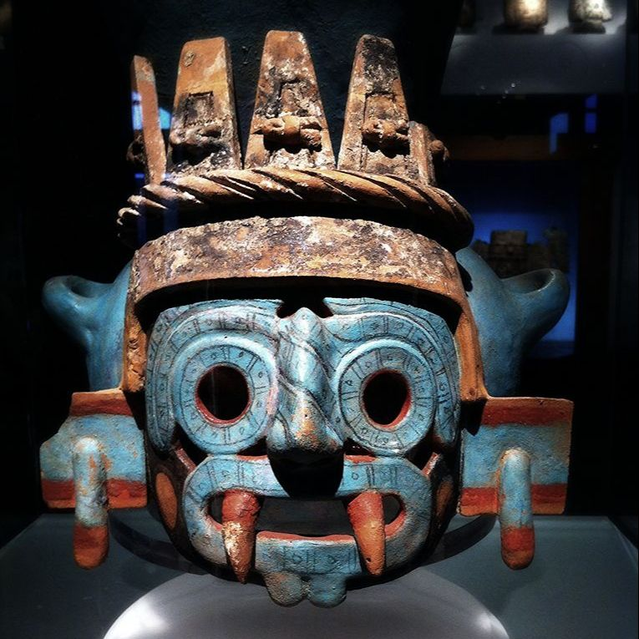

Slide 4
