Slide 1
Egyptian Hierarchy

Slide 2
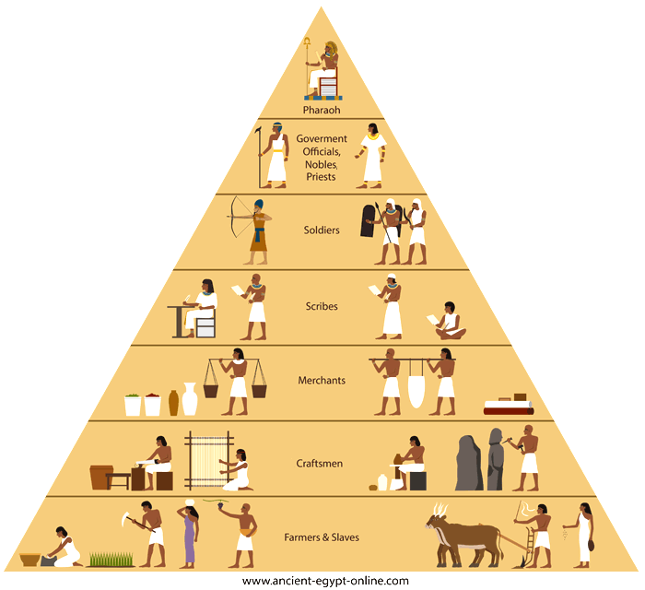
J

