Slide 1
Friday 5th March 2021 Book Week Final Task

Slide 2
Create a PowerPoint presentation on an Endangered Animal of your choice. On the next 7 slides is my presentation relating to Giant Pandas.

Slide 3
Slide 1 - Introduce your animal Slide 2 – Appearance Slide 3 - Habitat Slide 4 - Diet Slide 5 – Why are they Endangered? Slide 6 – Fun Facts about your animal

Slide 4
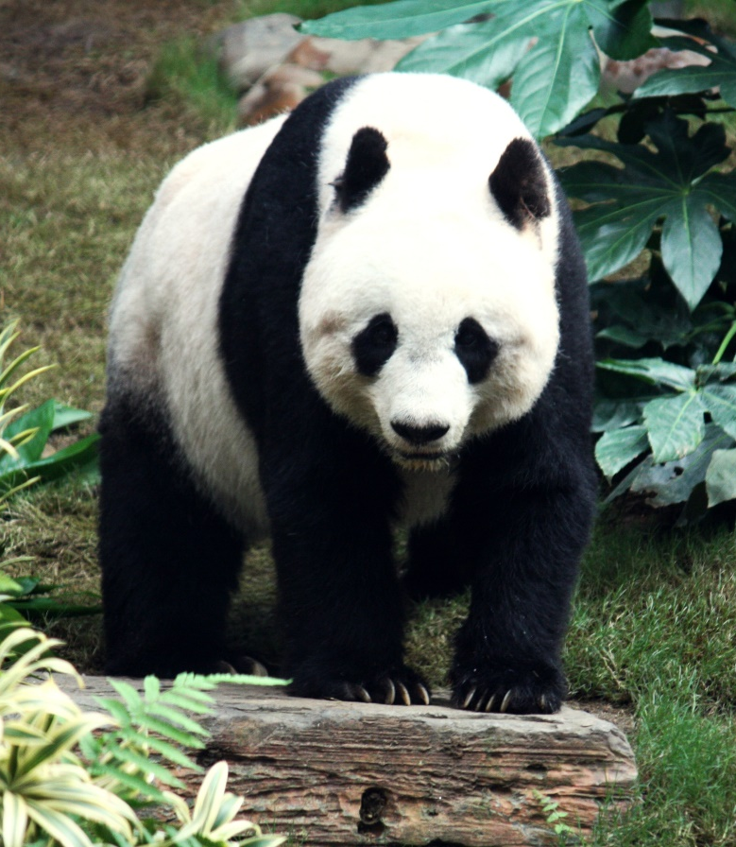
Giant Pandas
Giant pandas, with their black eyepatches and black and white fur, are a much-loved animal across the world. Pandas are mammals and belong to the bear family.

Slide 5
Appearance
The panda’s black and white colouring enables them to be well-camouflaged amongst the bamboo plants where they live.
They have five toes plus a thumb on each paw, which means they can grip the bamboo in the same way a human can grip with their hand.
An adult giant panda can grow to about 1.5 metres in length.
Did You Know…?
Most giant pandas are black and white, but a rarer type are brown and white.

Slide 6
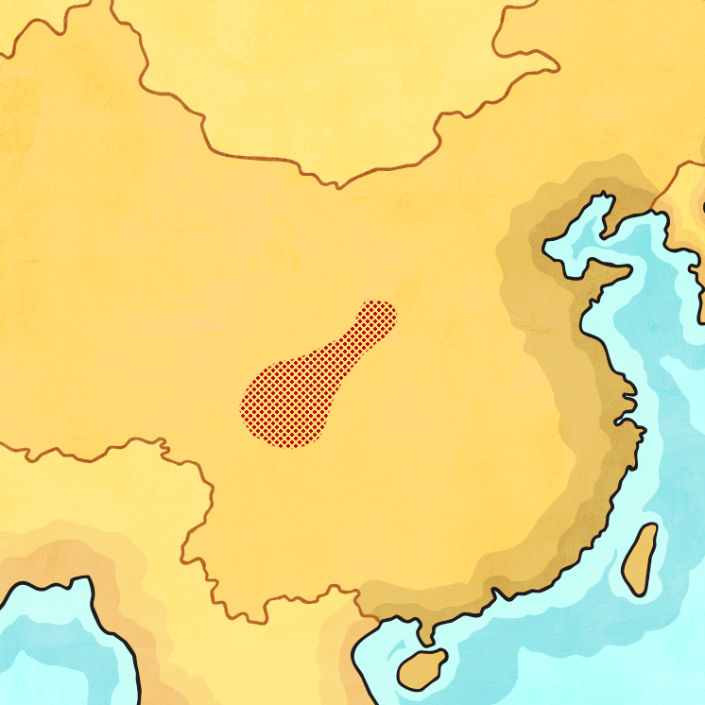
Habitat
Pandas are only found in China. They mainly live in the mountains in the south-west. This area is temperate, which means the temperature does not change much and it is neither very hot, nor very cold. The cool, wet forests are where pandas make their dens out of hollowed-out logs or tree stumps.
China
Did You Know….?
Pandas prefer to live alone rather than in groups.

Slide 7
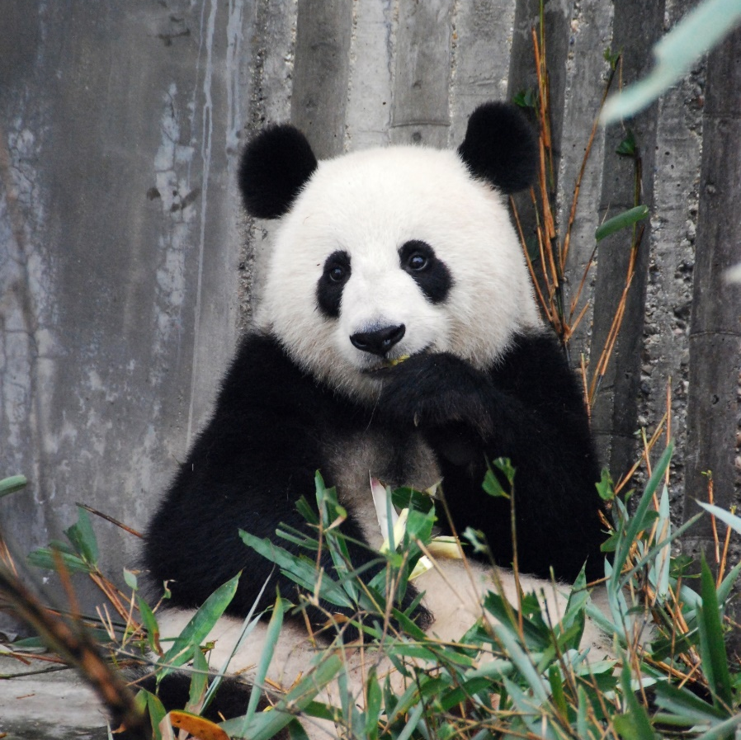
Diet
A panda’s main diet is bamboo. They spend much of their day eating, and consume around 20kg of bamboo every day. The newer shoots and leaves of the bamboo are the most nutritious part.
Did You Know…?
Pandas will occasionally eat fish, insects or birds if there is not enough bamboo available. They also eat fruit.

Slide 8
Pandas in Danger
Pandas are considered a vulnerable species. This means they are likely to become endangered unless more is done to protect their habitat. Their main threat is the cutting down of forests to build dams, railways and roads.
They were previously classed as endangered, but in recent years, they have been upgraded to ‘vulnerable.’ This is because panda numbers are finally on the rise after years of falling.
Did You Know…?
The giant panda population has risen 17% in the past ten years. There are approximately 2,000 giant pandas in the wild.

Slide 9
Fun Facts
Pandas are excellent climbers and can also swim.
A giant panda at London zoo inspired the World Wildlife Fund (WWF) logo in 1961.
Panda cubs are born pink and measure about the same size as a pencil!
Unlike other bears, pandas don’t hibernate.
A type of prehistoric panda lived around one to two million years ago.
All giant pandas are owned by China. Pandas living anywhere else in the world are on loan from China.

Slide 10
Task
Create a PowerPoint presentation about an Endangered Animal of your choice.
If you do not have access to PowerPoint you could create a non-chronological report on an Endangered animal. This could be done on a piece of paper or on the computer using a Word document.

