Slide 1
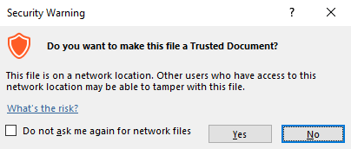
Guidance for Macros in PowerPoints
We use macros within PowerPoints to increase the interactivity of our presentations. Follow this simple process to get the most out of this resource.
What to do:
Open the PowerPoint file and enable editing.
A security warning box may appear. Click yes.
Click enable content.
Enter presentation mode (start the slide show).

Slide 2
Science
Scientists and Inventors
Year One
Science | Year 6 | Scientists and Inventors | Marie Maynard Daly | Lesson 3

Slide 4
Aim
To explain how diet affects the way the body functions.
Success Criteria
I can identify the positive and negative effects that different foods have on my body.
I can identify where my food comes from.
I can explain how cholesterol affects the body.

Slide 5
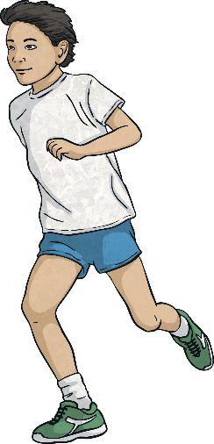
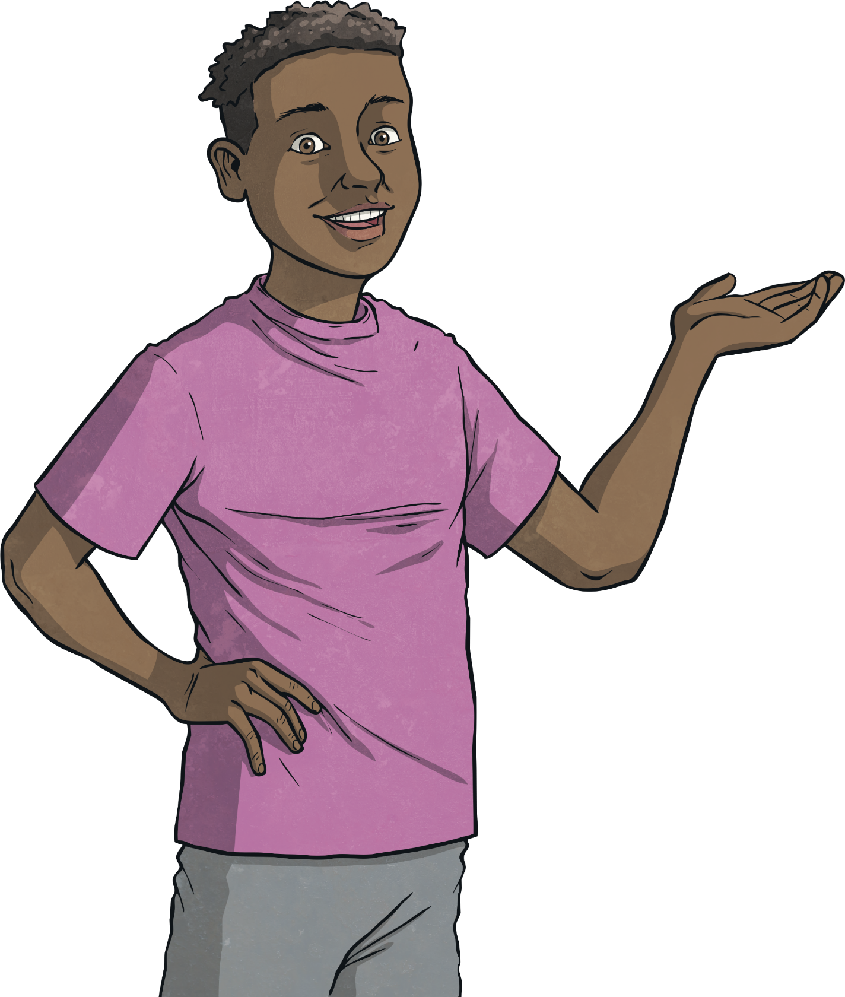
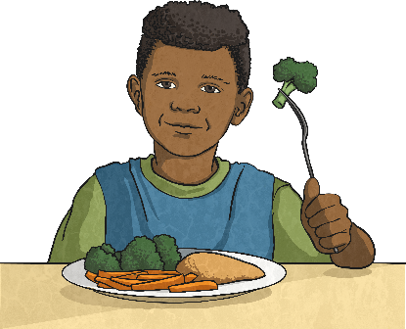
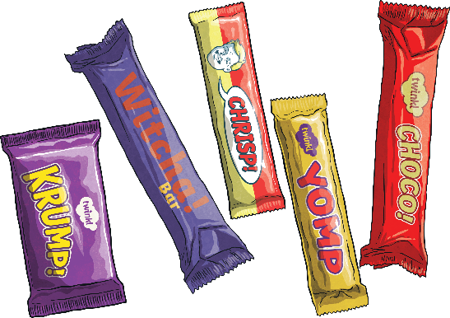
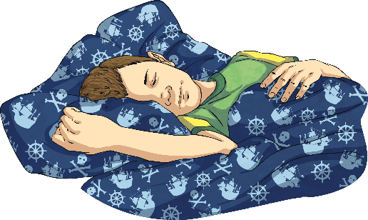
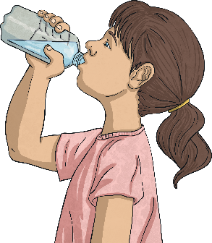
Keeping Healthy
What do you do to stay healthy?
Eat healthily
Exercise
Avoid too much ‘junk’ food.
Sleep enough
Drink plenty

Slide 6
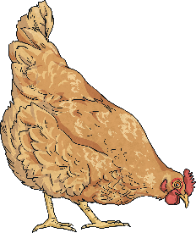
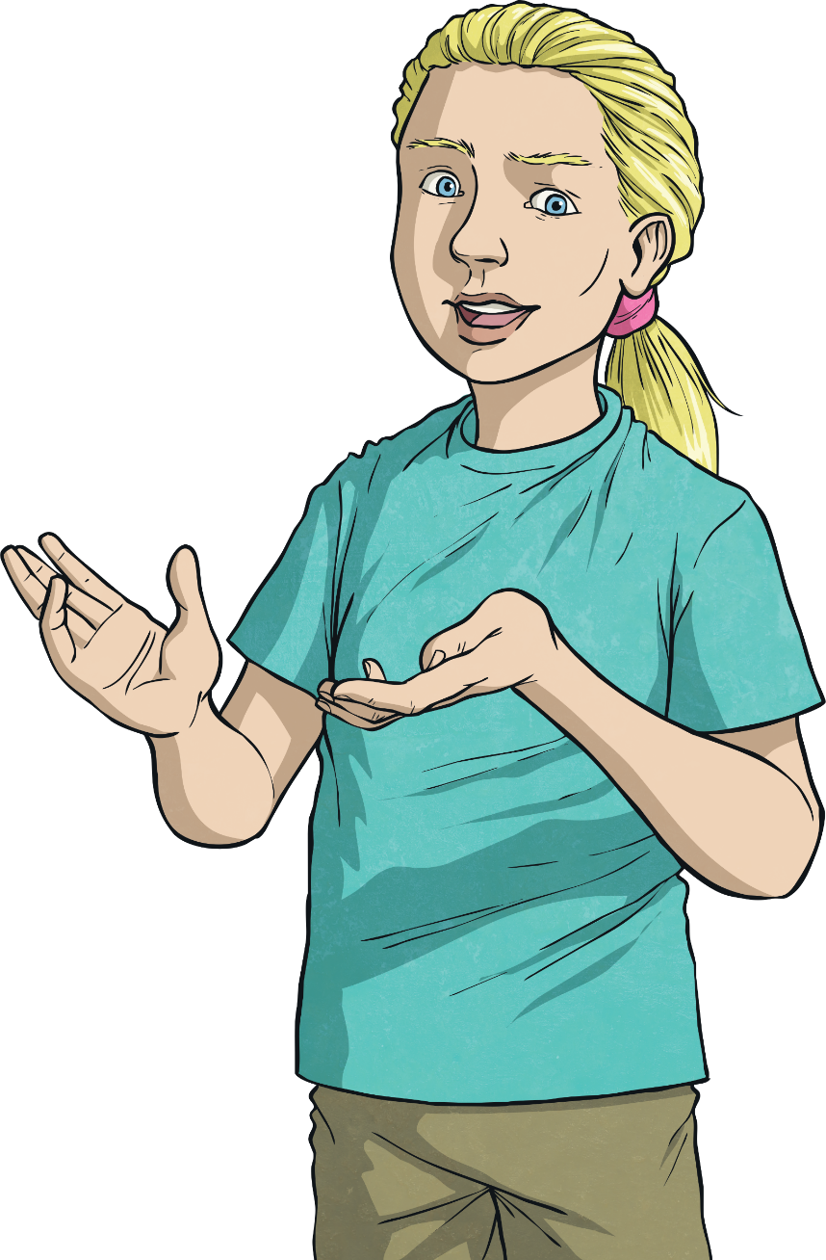
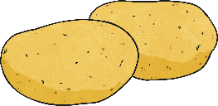
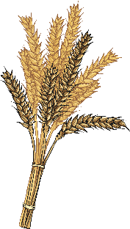
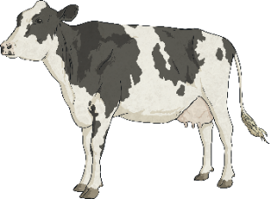
Food Sources
Today we are going to focus on how food keeps us healthy.
Chicken
Potato
First, we’re going to think about where our food comes from.
Wheat
Cow
Look at these food sources and think about all the foods that humans can get from each one.

Slide 7
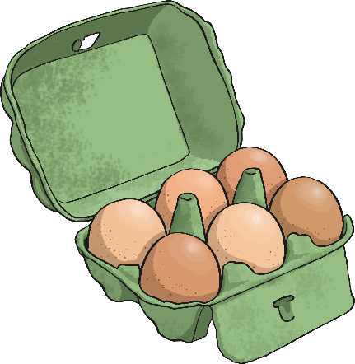
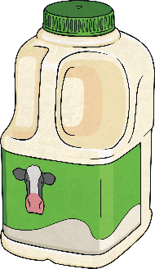
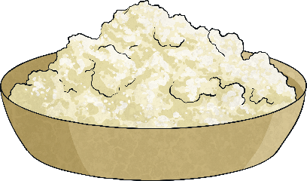
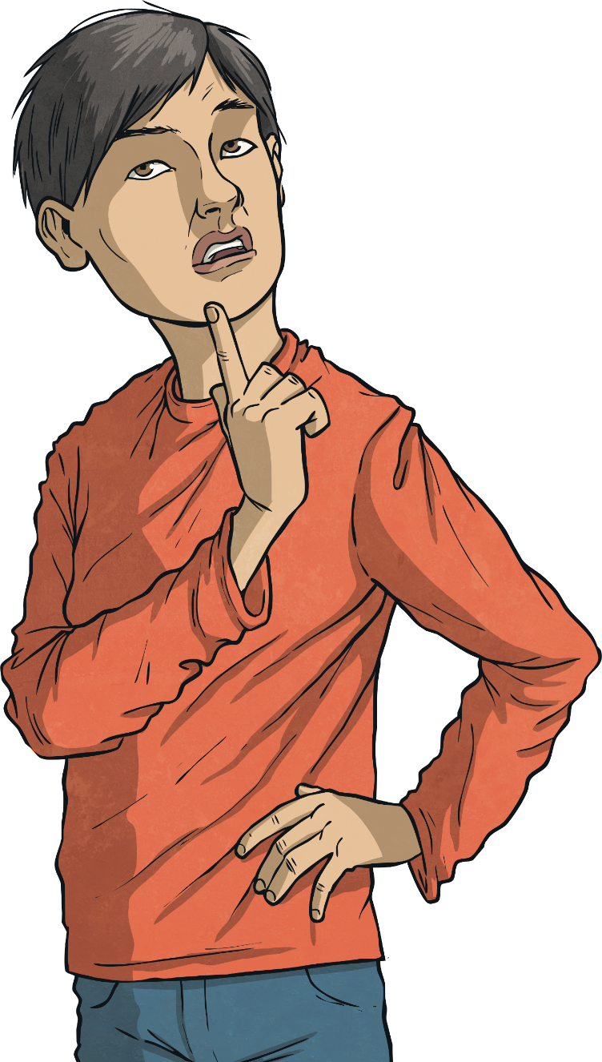
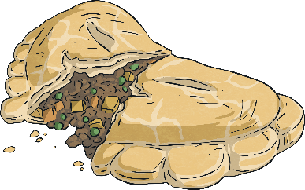
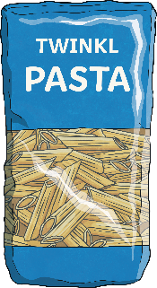
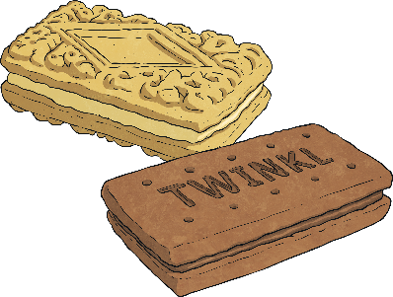
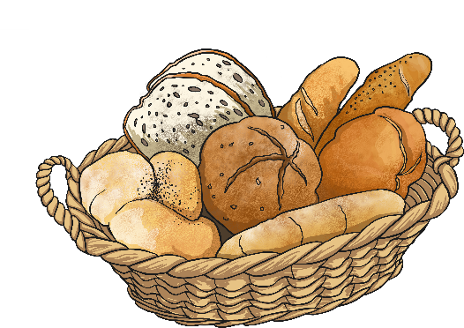
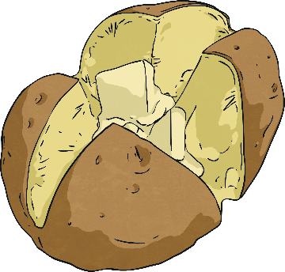
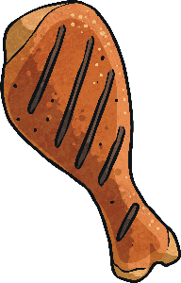
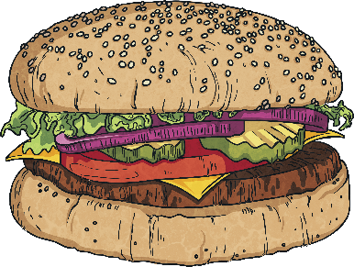
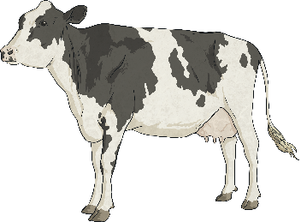
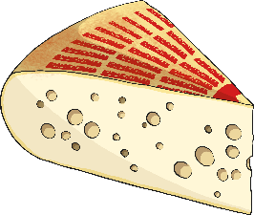
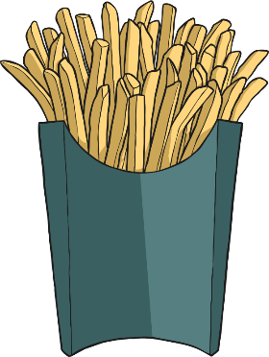
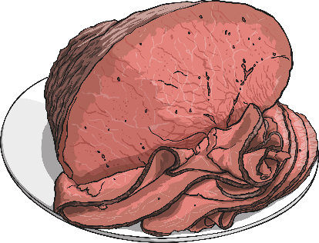
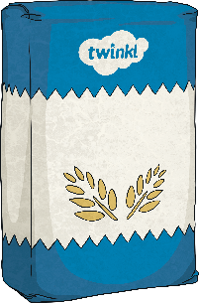
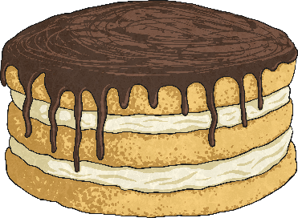
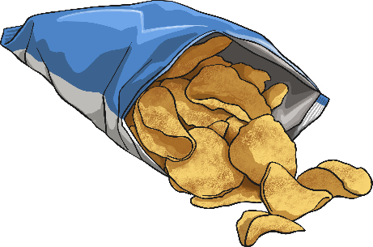
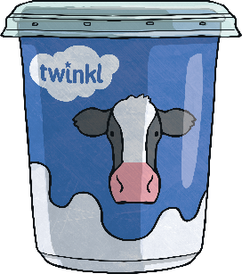
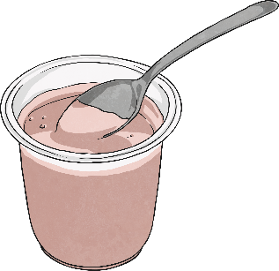
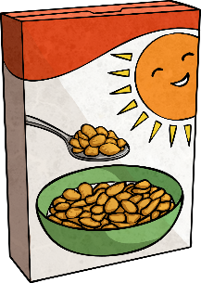
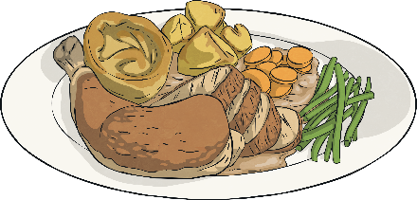
Food Sources
Did you think of any others?
mince
pasta
biscuits
mash
milk
eggs
roast potatoes
chicken
potato
wheat
cow
chicken drumsticks
jacket potatoes
bread
burger
cheese
cakes
chips
roast chicken
chicken nuggets
crisps
flour
beef
yoghurt
breakfast cereal
cream

Slide 8
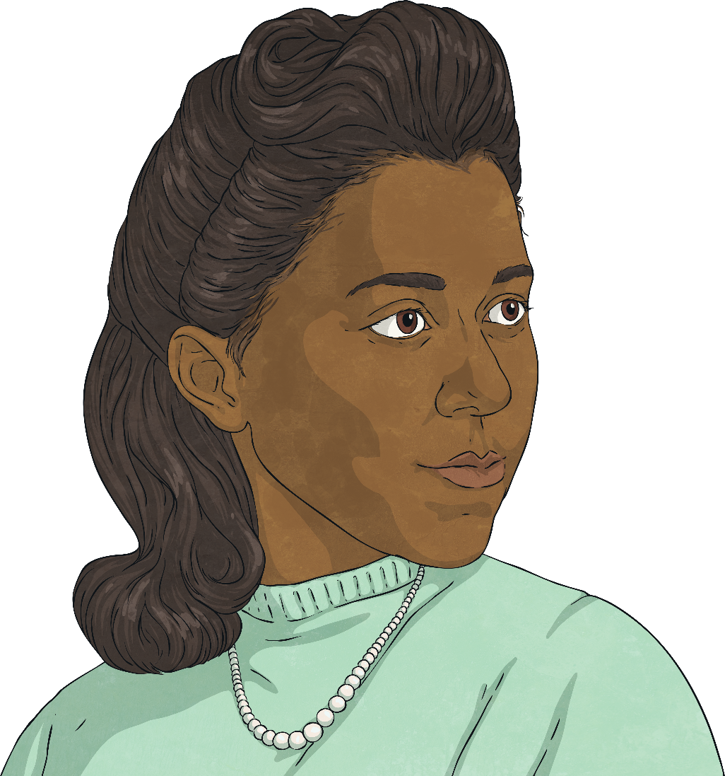
Marie Maynard Daly
Someone who researched the effects of foods on the body was Marie Maynard Daly.
Daly tutored students for a year before pursuing a PhD at Columbia under the direction of Dr Mary L. Caldwell, who was studying digestion in the human body. Marie also chose to study the chemicals affecting human digestion.
Marie Maynard Daly studied chemistry in New York, after attending an all-girls school that supported her interest in science.
Marie Maynard Daly became the first black woman with a PhD in chemistry in the USA.
She graduated with a degree from Queens University in 1942. She then took just one more year to get a master’s degree while working as a lab assistant.

Slide 9
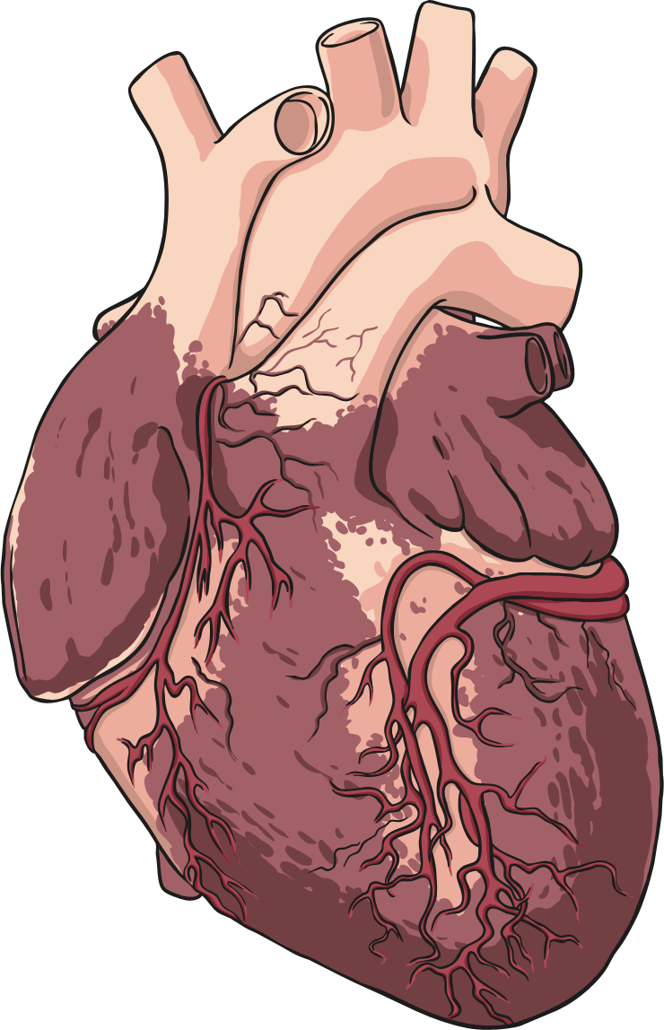
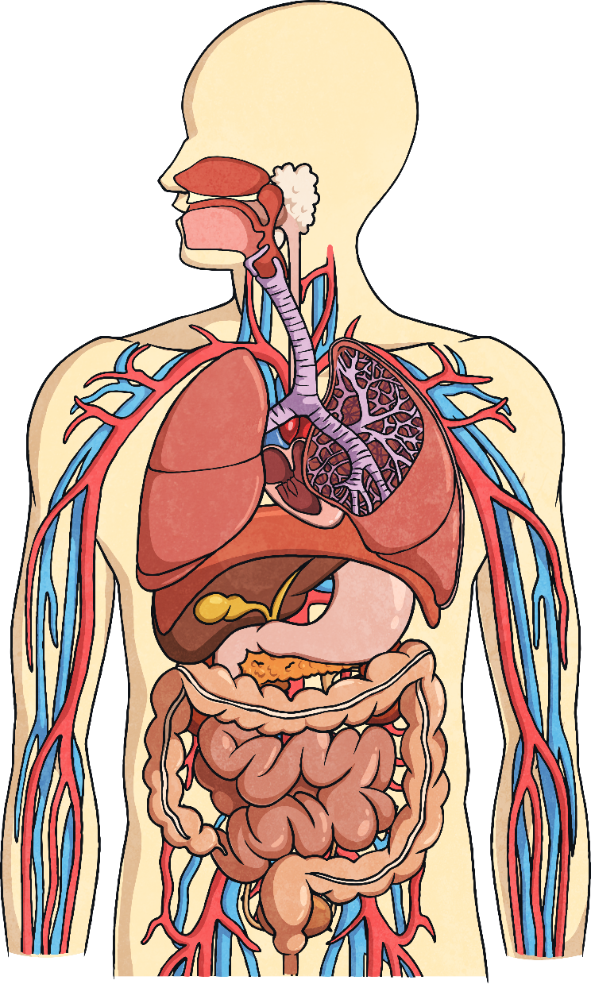
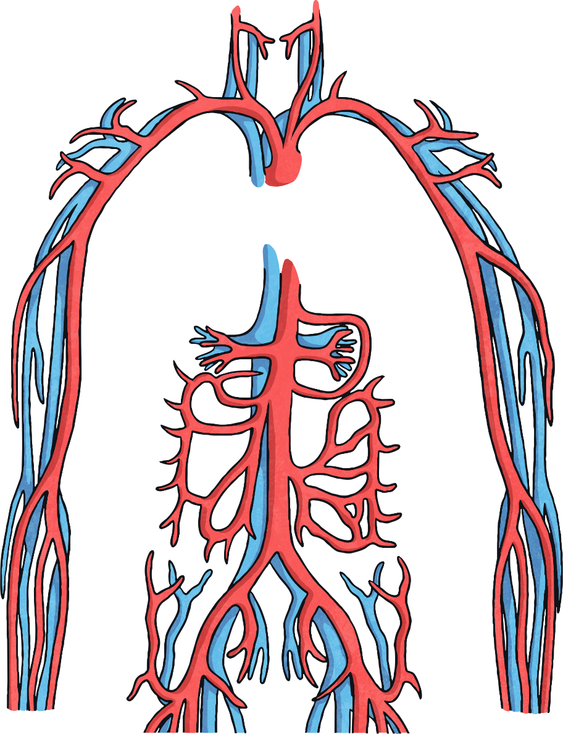
Marie Maynard Daly
Now a doctor, Marie continued to study the chemistry of the human body.
She made huge advances in our understanding of how the heart and circulatory system are affected by sugar and cholesterol in our diets.
Her work has demonstrated that too many fatty and sugary foods can make the arteries narrower and can cause heart disease.

Slide 10
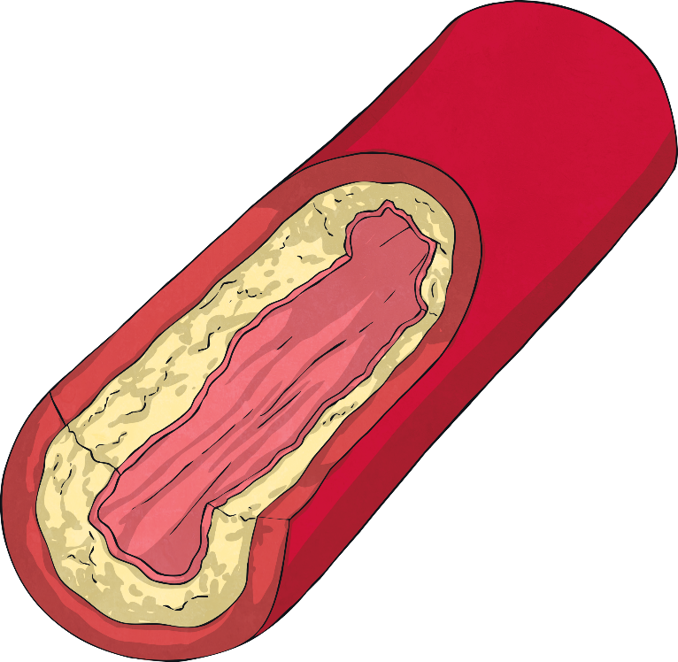
Cholesterol
Cholesterol is a type of fat that travels in the blood. It only comes from animal products.
Our own livers actually make some cholesterol as some parts of our bodies need it.
We now know that there are two types of cholesterol.
One is good for keeping our blood vessels clean.
The other does the opposite - it can build up and block blood vessels which can be very dangerous. This was the type Marie Maynard Daly was interested in.

Slide 11
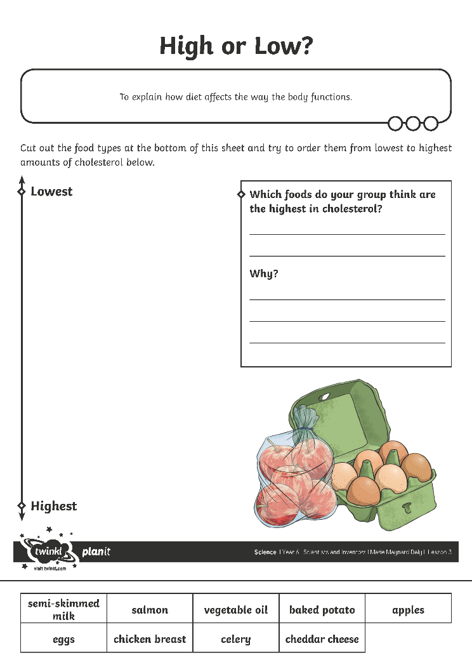
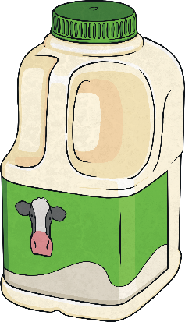
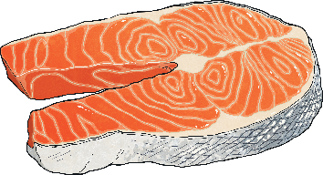
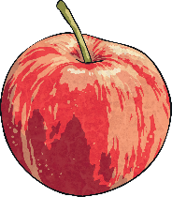
Cholesterol
Cut up the foods on your High or Low? Sheet.
Think about which foods might have the highest amounts of cholesterol, then try to order them from highest to lowest.

Slide 12
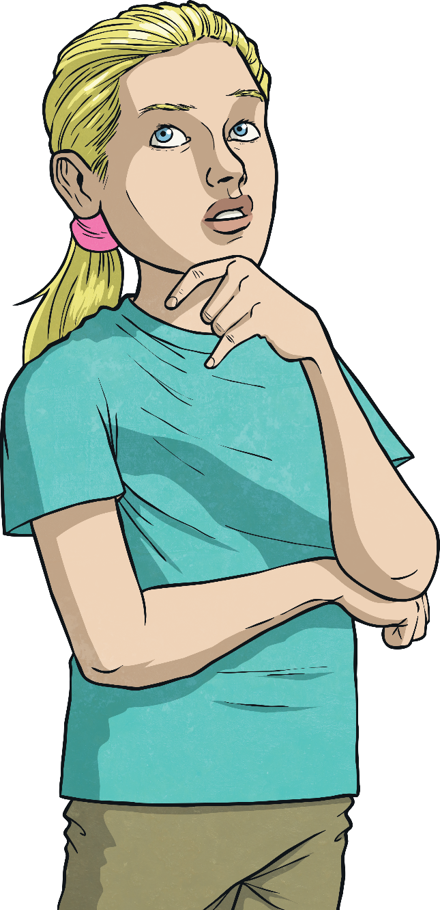
Cholesterol
Here are the foods in order from lowest to highest amounts of cholesterol. They are shown here with the amount of cholesterol per 100g.
Remember, some cholesterol is good for you and that fatty foods can be enjoyed as an occasional treat as part of a healthy diet.
How close were you?
Food | Amount of cholesterol
apples | 0mg
vegetable oil | 0mg
baked potatoes | 0mg
celery | 0mg
semi-skimmed milk | 8mg
salmon | 55mg
chicken breast | 85mg
cheddar cheese | 105mg
eggs | 373mg
Did any surprise you?
Food with high levels of cholesterol can often be good in other ways, including
as a source of protein.
What do you notice about the foods containing cholesterol?
They come from animal sources - in fact, cholesterol only comes from animal products.

Slide 13
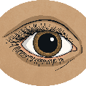
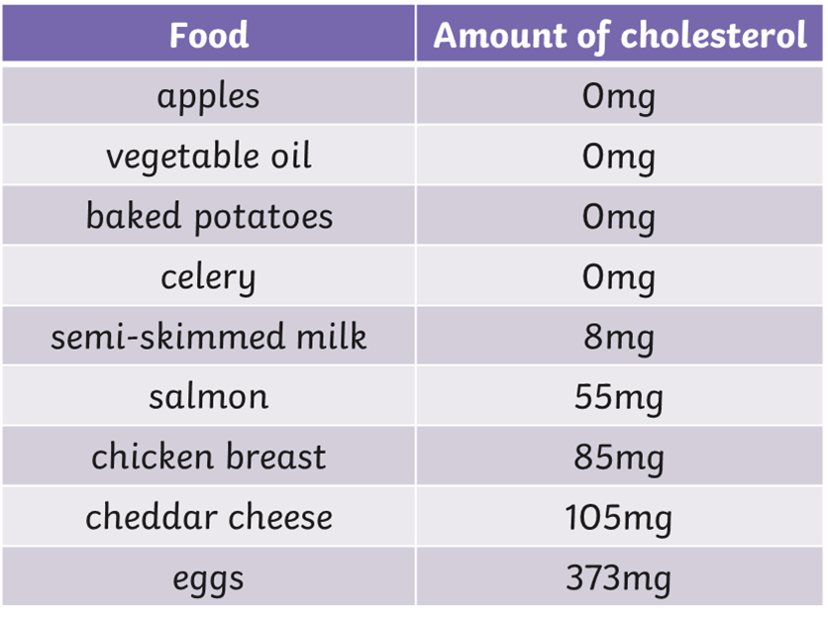
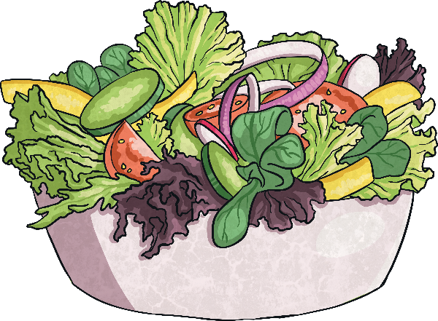
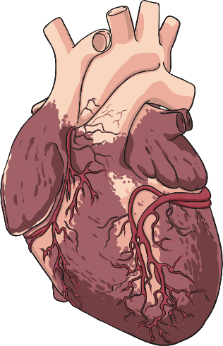
Cholesterol
table
Foods from plants contain no harmful cholesterol.
Health specialists advise people who need to lower their cholesterol levels to eat less meat and cheese. This should help them to keep their hearts healthy.
It was Marie Maynard Daly’s work which proved that too much cholesterol could narrow blood vessels and lead to serious heart problems.

Slide 14
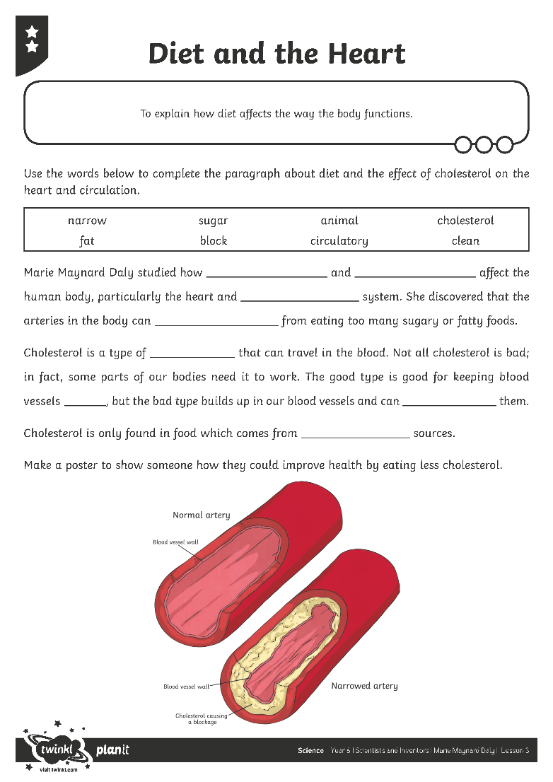
Diet and the Heart
Complete this worksheet. Use the word bank to help you to complete the paragraph about diet and the effects of cholesterol on the heart and circulation.

