Slide 2
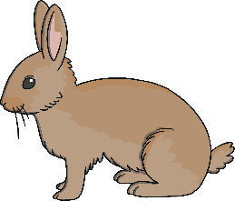
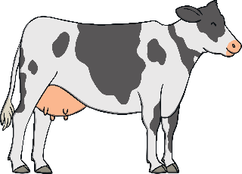
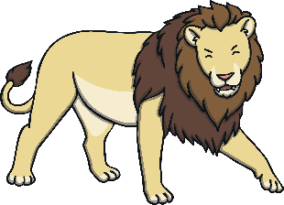
Staying Alive
Animals need to eat to stay alive.
Different animals eat different types of food.
Which of these animals does not eat grass?
rabbit
cow
lion

Slide 3
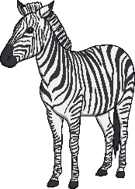
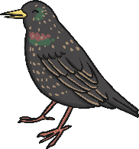
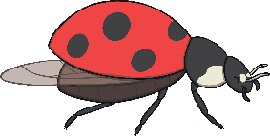
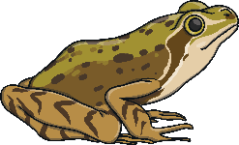
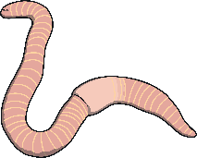
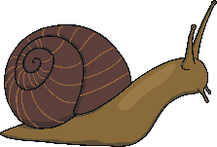
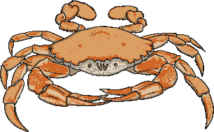
Carnivores
Some animals eat other animals.
These animals are called carnivores.
Carnivores eat:
mammals
fish
birds
insects
and other animals:

Slide 4
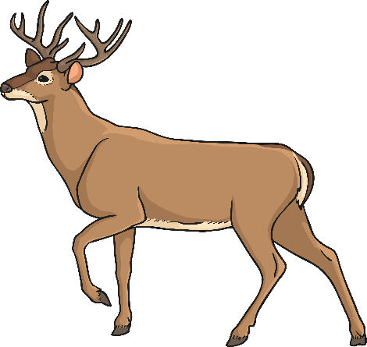
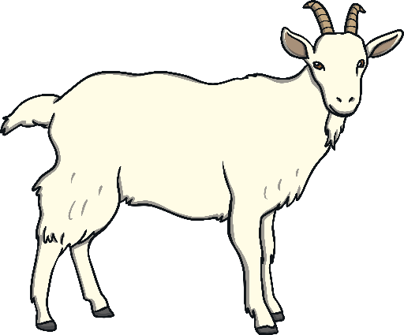
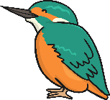
Carnivores
Carnivores can be big or small.
Which of these animals do you think is a carnivore?
kingfisher
deer
goat

Slide 5
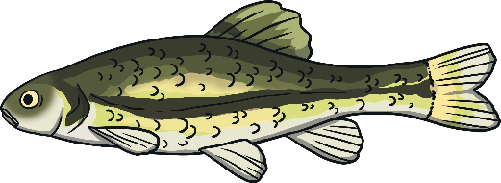
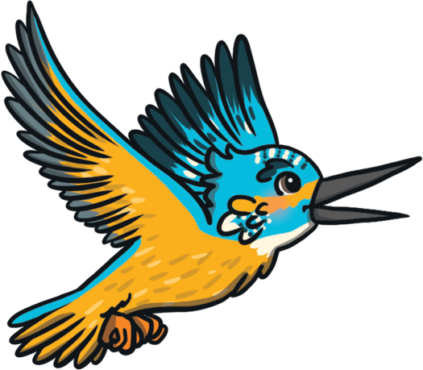
Carnivores
Kingfishers are small birds.
They only eat other animals.
They are carnivores.
They eat small fish and other little animals like tadpoles.

Slide 6
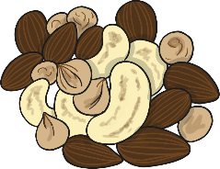
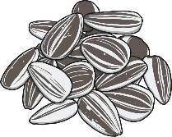
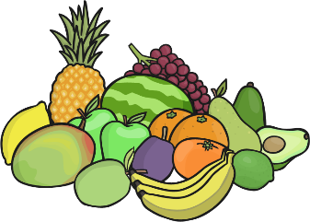
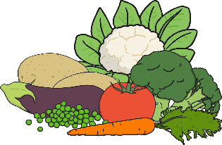
Herbivores
Some animals eat only plants.
These animals are called herbivores.
Herbivores eat:
grass
nuts
seeds
flowers
fruit
vegetables

Slide 7
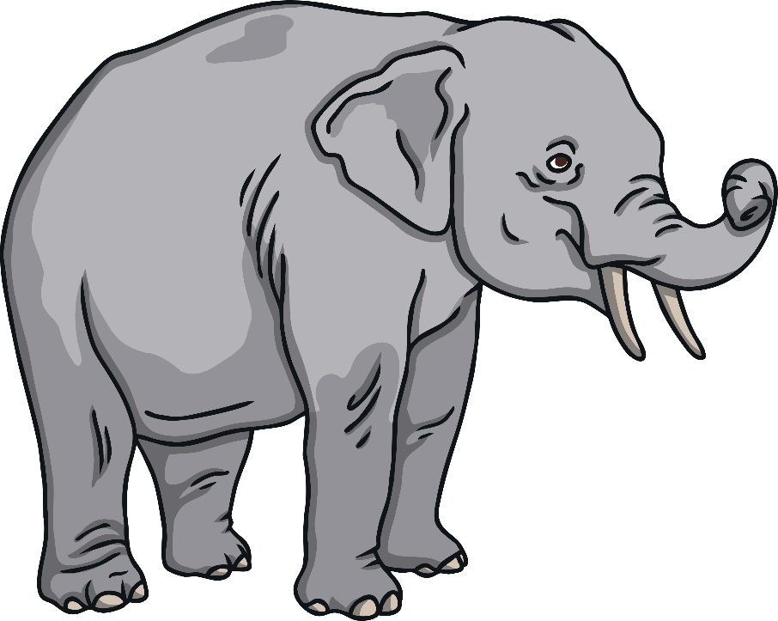
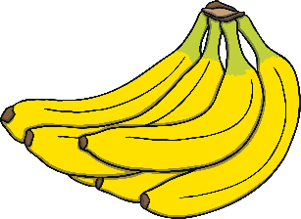
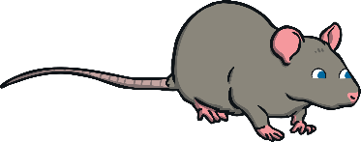
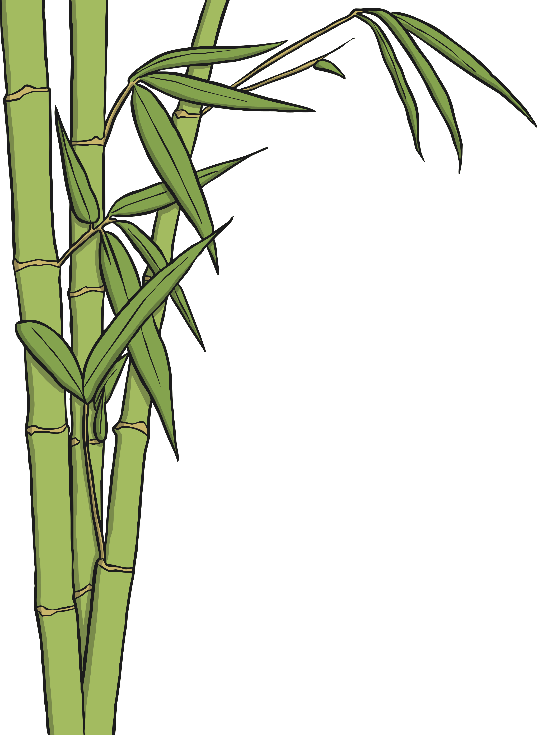
Herbivores
Elephants are herbivores.
Which of these can they not eat?

Slide 8
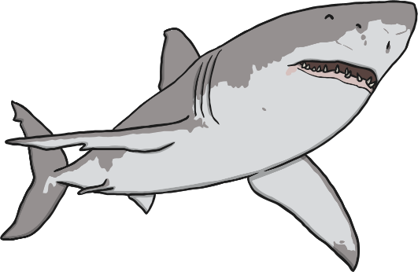
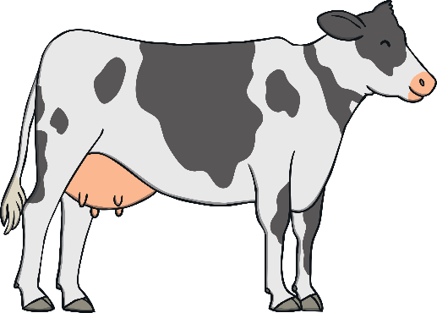
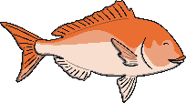
Omnivores
Carnivores eat only animals.
Herbivores eat only plants.
But some animals eat animals and plants.
These animals are called omnivores.

Slide 9
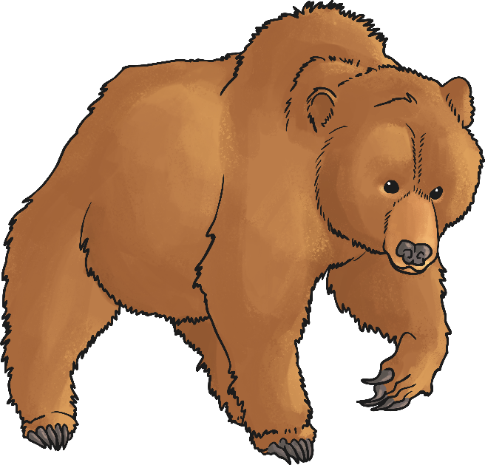
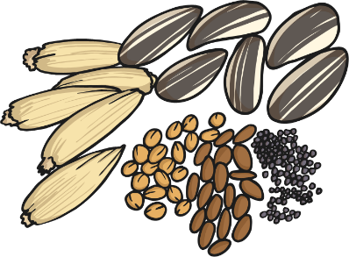
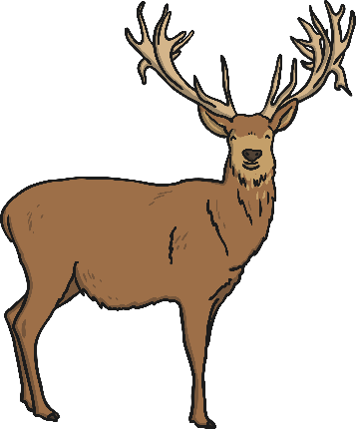
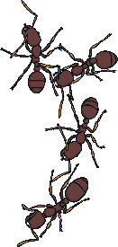
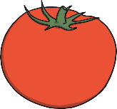
Omnivores
Omnivores survive by eating both plants and animals.
This can be a good way of staying alive. If they cannot find meat, omnivores can eat plants instead.
Omnivores come in all shapes and sizes!
Grizzly bears eat seeds, berries and grass.
They also eat deer, fish and insects.

Slide 10
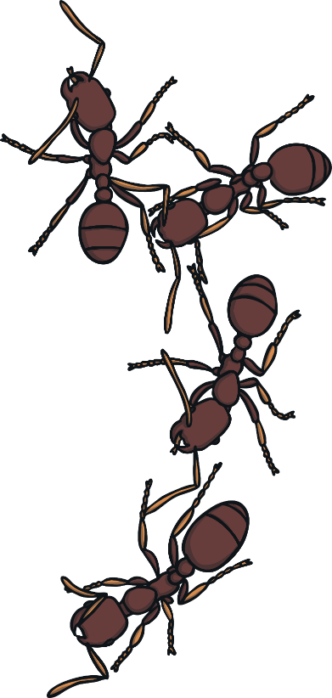
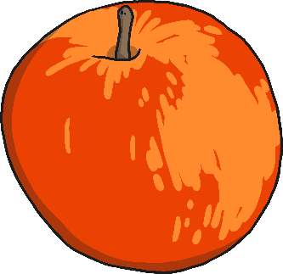
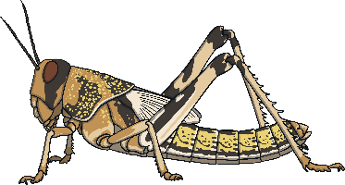
Omnivores
Ants are tiny omnivores.
Most ants eat a mixed diet of plants and meat. This might include leaves, nectar and fruit, as well as insects and dead animals.

Slide 11
What about Humans?
Do you think humans are carnivores, herbivores or omnivores?
What did you eat yesterday?
Humans are able to eat meat and plants.
Some people eat only plants, but most humans have both plants and meat in their diet.
This makes humans omnivores.

