Slide 1
GEOGRAPHY

Slide 2
Learning Objective WALT
To be able to compare and contrast precipitation in Italy and England
Notes:
2

Slide 3
Precipitation means rainfall

Slide 4
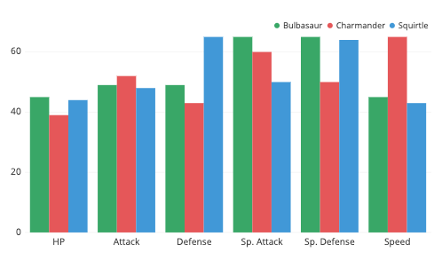
I would like you to create a grouped bar graph
Example of a grouped bar graph
Using the precipitation measurements on the next slide
please create a bar graph

Slide 5
This what the bar graph should look like
Average precipitation in 2019 (mm)
140
120
100
80
60
40
20
0
England
Italy
You can either draw the grouped bar graph or you can do it on the computer – instructions for this are after the precipitations measurements.
January
February
March
April

Slide 6
Average precipitation in 2019 (mm)
 | England | Italy
Jan | 82 | 66
Feb | 64 | 73
Mar | 65 | 57
Apr | 58 | 80
May | 58 | 52
June | 91 | 3
July | 62 | 19
Aug | 69 | 36
Sep | 83 | 73
Oct | 128 | 113
Nov | 140 | 115
Dec | 90 | 81

Slide 7
Open word document
Click on insert
Click on chart
Press ok - column highlighted
There is blue line – bottom right hand – hover over and an arrow should appear – holding mouse down, drag blue line down to number 13 then reduce by one column
In IB – type ENGLAND
In 1C – type ITALY
In A2 to A13 type in the months
Input data
Now, click on the bar graph and it will appear on your word document.
Remember to label your graph

