Slide 1
Learning Objective:
To add fractions

Slide 2
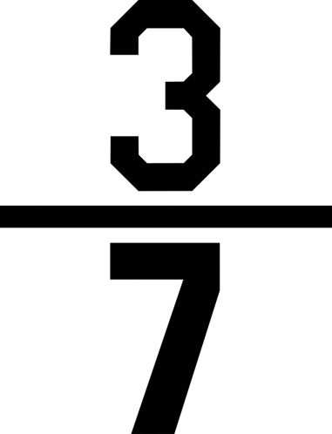
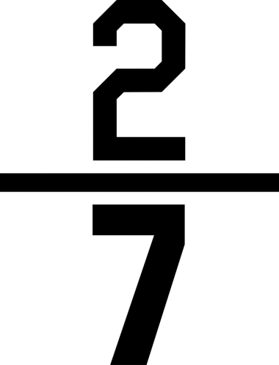
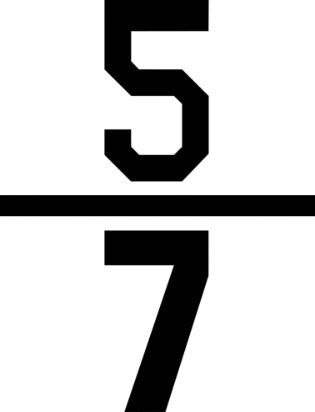
Adding fractions that have the same denominator is quite simple.

Slide 3
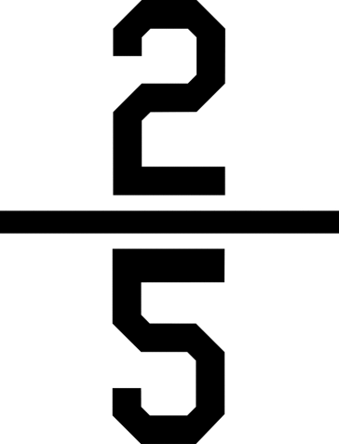
When the denominators are different it is a little trickier.
You have to find a fraction that they both can go in to. Which times table would 3 and 5 both have in their times tables?

Slide 4
I hope you said 15
So the denominator becomes 15 for both fractions.
? ? ?
15 15 15

Slide 5
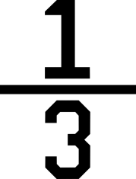
Now you have to say ‘What did I times 3 by to get to 15?’ Answer = x 5 so you must do that to the numerator on the 1/3 fraction
5 ? ?
15 15 15
Then you must ask ‘What did I do to the 5 to get 15?’ Answer = x 3 so you must do that to the numerator on the 2/5 fraction
5 6 11
15 15 15

Slide 6
Quite tricky isn’t it?
Let’s have another try

Slide 7
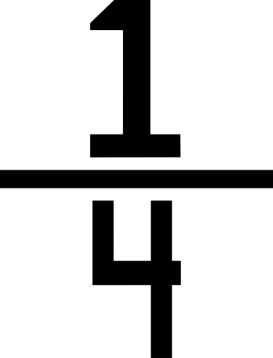
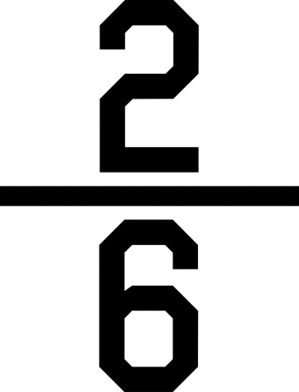
Which times table is in both denominators?

Slide 8
You should have the answer 12
? ? ?
12 12 12

Slide 9
Now you have to ask, ‘What did I do to the 4 to get to 12?’ Answer = x 3 so you must do that to the numerator on that fraction
3 ? ?
12 12 12

Slide 10
Now you have to ask, ‘What did I do to the 6 to get to 12?’ Answer = x 2 so you must do that to the numerator on that fraction
3 4 7
12 12 12

Slide 11
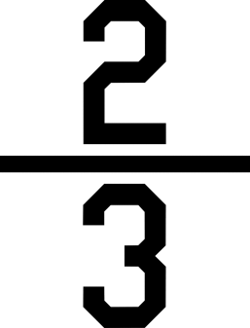
Now you have a try ☺
Which times table is in both denominators?

Slide 12
Answer
8 3 11
12 12 12

Slide 13
Sometimes you only have to change one of the fractions
12 5 17
18 18 18

Slide 14
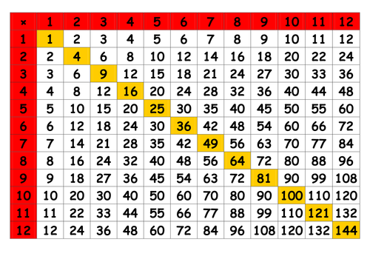
Please have a go at the worksheets which are on home learning. Just remember to find a common times table for both denominators. Times table grid below to help you – you can do this! ☺

