Slide 1
Punctuate spoken sentences
Stage 3 Punctuation 1.2
National Curriculum Teaching Point:
Introduction to inverted commas to punctuate direct speech

Slide 2
Have you noticed some punctuation around the words that are being spoken when we write it as direct speech?
These are called speech marks.
They show that these are the words that are being spoken. What other punctuation marks do you notice?
If it’s sunny at the weekend, we’ll go to the beach.
Jamal said, “If it’s sunny at the weekend, we’ll go to the beach.”
Jamal

Slide 3
Speech marks only go around the words the person says - the words that would come out of your mouth if you were saying it.
Any punctuation goes inside the speech marks.
What’s for dinner?
“What’s for dinner?” asked James.

Slide 4
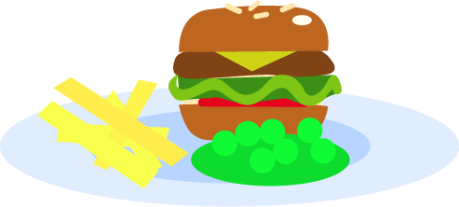
What other punctuation do you notice? Where is it?
? inside the speech marks.
“What’s for dinner?” asked James.
No capital letter for asked.
Full stop at the end of the full sentence.

Slide 5
What other punctuation do you notice? Where is it?
Comma inside the speech marks.
“Time for bed,” yawned Dad.
No capital letter for yawned.
Full stop at the end of the sentence.

Slide 6
What other punctuation do you notice? Where is it?
! Inside the speech marks.
“It’s my birthday party today!” cheered Yasmin.
No capital letter for cheered.
Full stop at the end of the full sentence.

Slide 7
What other punctuation do you notice? Where is it?
Comma inside the speech marks.
“Look up in the tree,” whispered Chen.
No capital letter for whispered.
Full stop at the end of the sentence.

Slide 8
Add these punctuation marks into the sentences. Think carefully about where they need to go.
?
!
,
“I’d like pasta for tea ” thought Eve.
“Catch the ball ” called Ahmed.
“What would you like to do at the weekend, Ruth ” asked Grandma.

Slide 9
Add these punctuation marks into the sentences. Think carefully about where they need to go.
?
!
,
“How many children are having packed lunch today ” Mr Edwards asked.
“Sixteen children are having packed lunch today ” said Mr Edwards.
“You forgot your lunch ” Mr Edwards shouted.

Slide 10
Re-write these sentences, punctuating them correctly.
I’m going to ride my bike in the park Chen told his mum.
Can I have a cheese sandwich please asked James.
Don’t go in there shouted the man.

Slide 11
Re-write these sentences, punctuating them correctly.
“I’m going to ride my bike in the park,” Chen told his mum.
“Can I have a cheese sandwich please?” asked James.
“Don’t go in there!” shouted the man.

