Slide 1

The Pyramids
A guide by King Khufu.

Slide 2
I am Pharaoh Khufu. Welcome to my guide to the Pyramids.
I have my very own pyramid in Giza, don’t you know?
The pyramids are more than 4500 years old, and are protected by the mighty Sphinx. They were built during the time of The Old Kingdom.

Slide 3
The Tombs of the Kings
Pyramids were built to house the mummies of the Pharaohs, and our families.
We Egyptians thought that the Pharaoh could live forever if his body was mummified, and the perfect thing to protect his body and all the things he would need in the afterlife was a pyramid!

Slide 4

Who built the pyramids?
Farmers
Stonemasons
Carpenters
Labourers
Surveyors
It could take as many as 4000 men to build ONE pyramid! But don’t worry, we paid them with housing, food, and clothing.

Slide 5
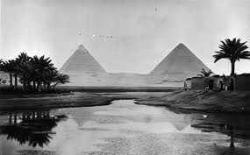
Where were the pyramids built?
We chose to build most of the pyramids on the Western side of the River Nile. The dry desert heat there stopped our bodies and our lovely loot from rotting away.

Slide 6
How were the pyramids built?
The workers cut the stone blocks and dragged them into place. Some pyramids required 2 million blocks, which were carried by boats on the Nile!
The blocks were pulled up a steep ramp onto the pyramid using wooden sledges.
Years and years of hard work passed, and the final stone was placed on the top.
The pyramid was then made smooth and shiny.
The burial chambers and passages were dug out last. Sometimes, we included booby traps to keep out pesky thieves.

Slide 7
The Pyramids at Giza
The pyramids at Giza were built for 3 Pharaohs and their families.
These were –
Khafre
Menkaure
(the most wonderful, magnificent and mighty) Khufu

Slide 8
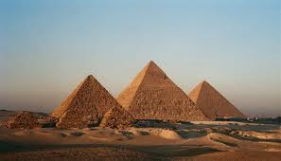

The Giza Plateau
The most famous pyramid is The Great Pyramid.
It is 140 metres high, which is about the same as almost 15 double decker buses lined up in a row. Pretty big, huh?
The Great Pyramid took 20 years to build, and inside it is the body of Pharaoh Khufu, (me!).

Slide 9
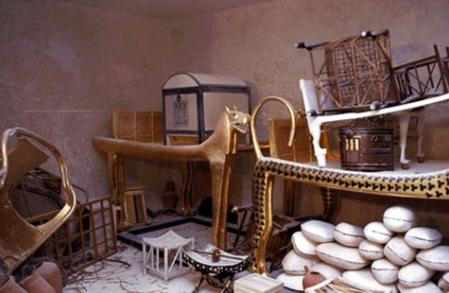
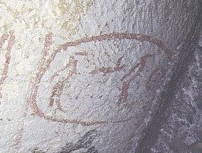
What the pyramids tell you!
From looking at the treasures and objects found in pyramids, historians have learned a lot about us Egyptians.
The hieroglyphics on the walls have also told historians about how Egyptians liked to live.
Sometimes, we’d even mummify a few slaves to serve us in the afterlife, or a particularly nice pet!

Slide 10
Eventually, we stopped building pyramids because they were just too easy for robbers to spot! Now, see if you can remember the answers to some of these questions…
Why were the pyramids built?
Where were the pyramids built?
How many people could work on a pyramid?
What is the most famous pyramid?
What was inside the pyramids?

Slide 11
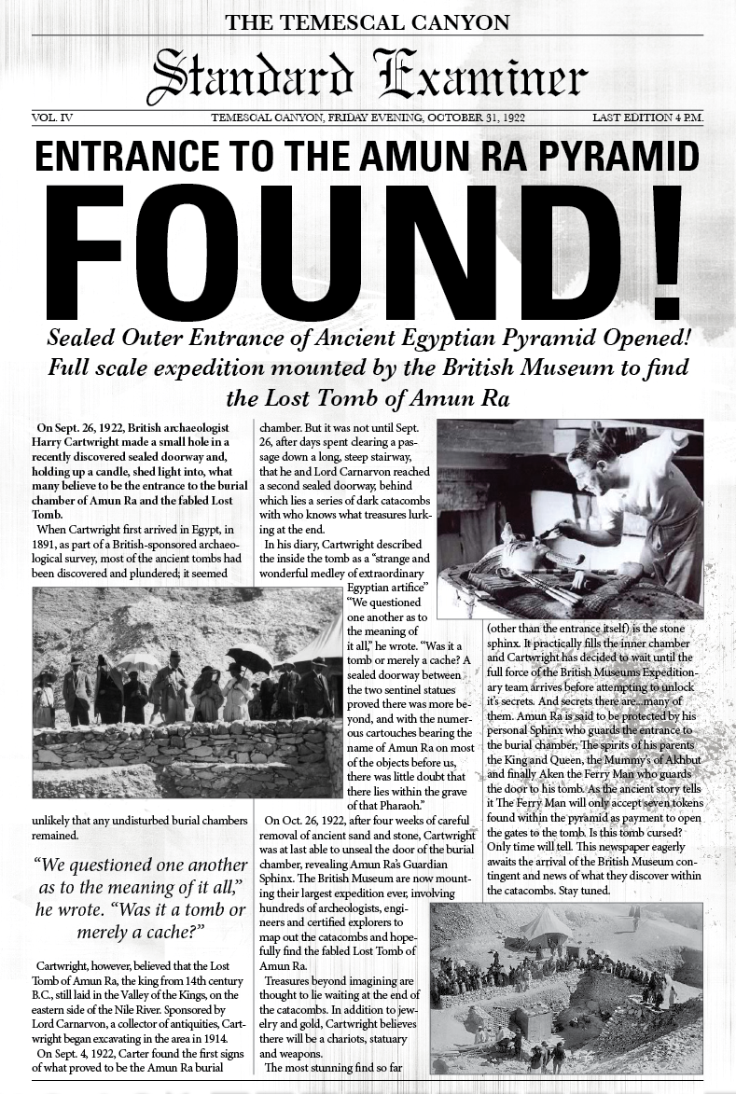
Just a reminder – a newspaper article should look something like this
Key Features
Name of Newspaper
Title for article (BOLD)
Written in columns
The 5 Ws – what, where, when, who, why
Picture
Caption for picture
Quote
Factual information
Written in past tense
Technical Vocabulary

