Slide 1

Design and
Technology
Notes:
1
1
1

Slide 2


Learning Objective
: to be able to design, draw and label a Roman camp
Success Criteria
: that you work is presented in a clear way
WALT
WILF
Notes:
2

Slide 3
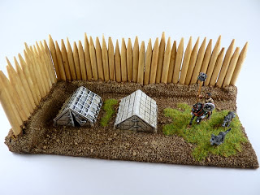
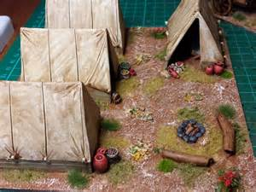
Here are two examples that you could follow or there are some simpler designs on Google.

