Slide 2
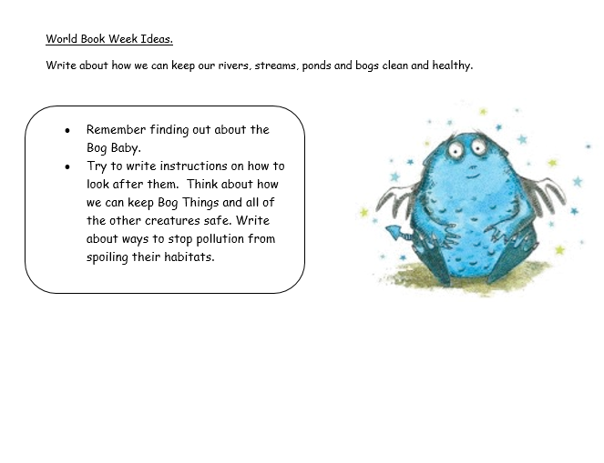
Task 1 After listening to the video for Monday see if you can think about how to keep our rivers, streams, lakes, ponds and bogs clean. Write about looking after a Bog Thing.

Slide 3
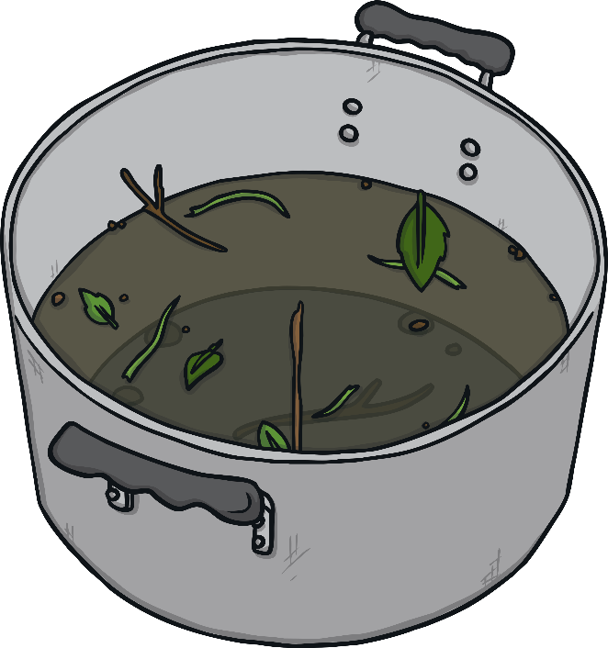
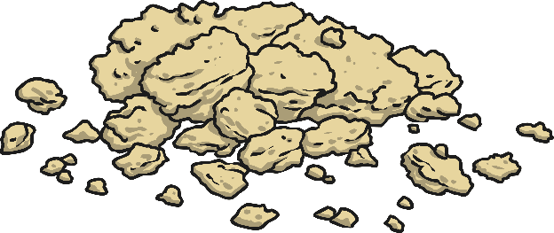
Writing Instructions
Instructions can help a person to do something that they have never done before. It tells them how to do it clearly and in a way that is easy to follow.
Today, you are going to write your own instructions to tell other people how to care for a Bog Thing. Remember to make sure the water is clean and not polluted.
Can you remember any of the important features that a good set of instructions needs?

Slide 4
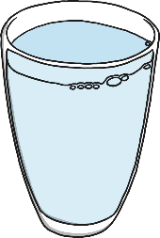
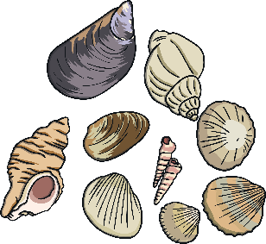
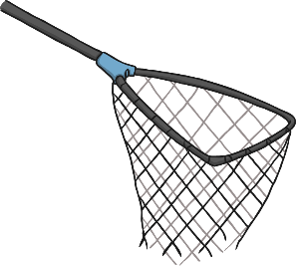
A List of What You Will Need
What will you need to take care of a Bog Thing?
Clean pond water
bucket
crumbs
shells
net
tub
gravel
cotton wool

Slide 5
Steps in Order
Did you manage to put your steps into the correct order?
1.
Get a bucket, some gravel and some shells.
2.
Add some gravel to the bottom of the bucket.
3.
Put some shells into the bucket.
4.
Place your Bog Thing carefully into the bucket.
5.
Pour some clean pond water into the bucket.
Remember to add numbers to your steps to make the correct order clear.

Slide 6
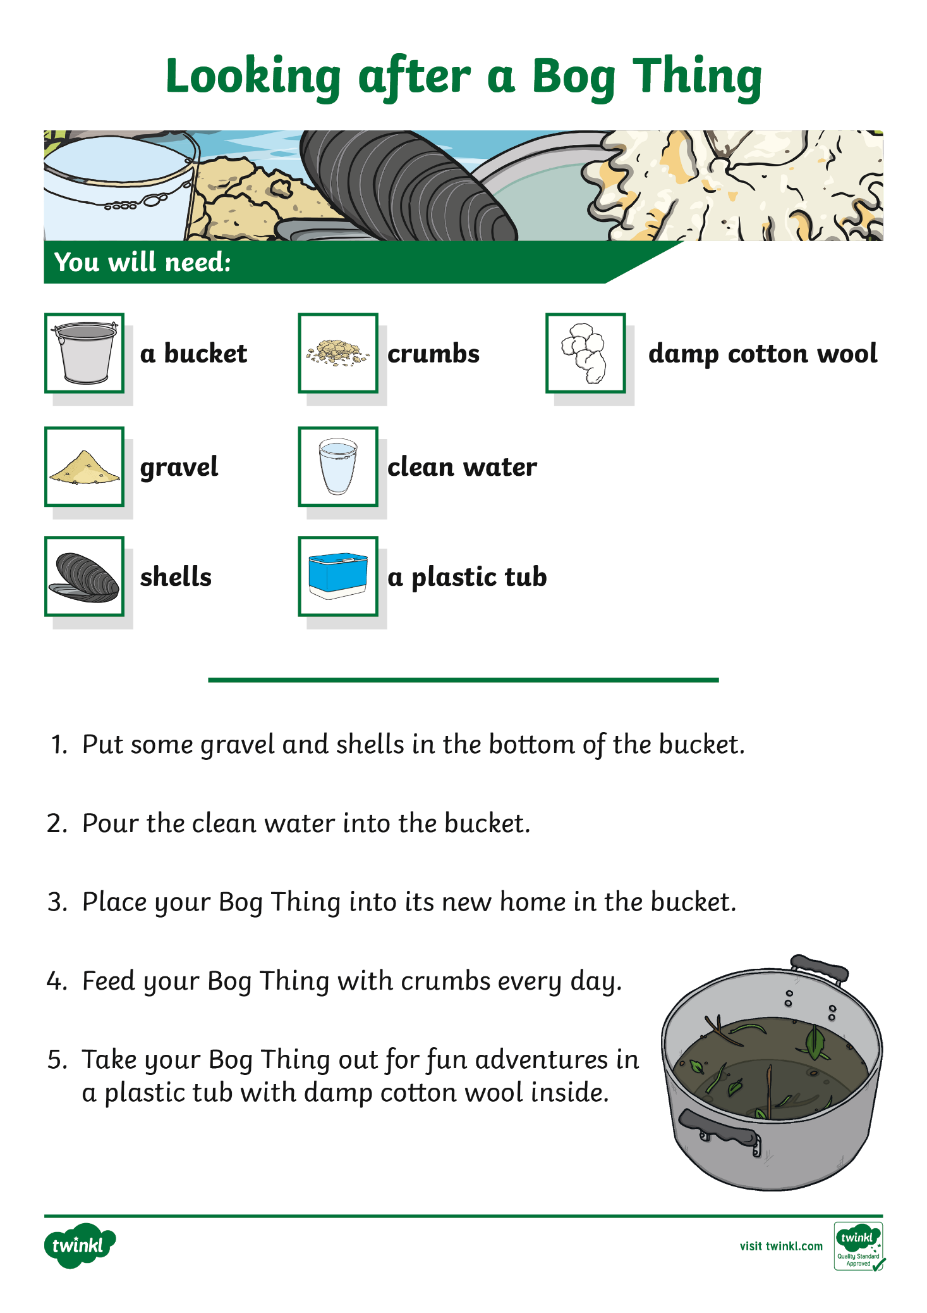
Example Instructions
What do you need to include in a good set of instructions?
Take a look at this example to give you some ideas.
Scroll Down

Slide 7
Example Instructions
Write a title
Write a list of what is needed.
Put the steps in order.
Start each step with a number to show the correct order.

Slide 8
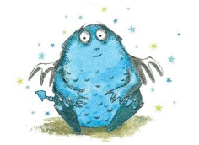
Check that the ponds, streams, rivers, bogs and lakes are clean.
Write about putting rubbish in the bin or taking it home with you so that none of it ends into our ponds, rivers, bogs and lakes. Remember to write that it is important to put the Bog Baby back into the habitat where it came from.

Slide 9
Task 2 Dreamer by Brian Moses and Bee Willey. Watch the story being told on Milk Shake with the link on the weekly plan. See which different creatures you can see and name. Look at the stream and see if you can spot the otter swimming in the clean water. Think about how all of the creatures need clean water.

Slide 10
Think about other creatures that need clean water without rubbish or pollution in it.
On another day you might like to use the otter template like the picture below and find out some facts about them and write some sentences about keeping them safe.
Remember to :
Put rubbish in the bin.
Use less plastic.
Keep habitats clean and safe for all of our wildlife. Thank you and remember to send your photos of your work.

